Slide 1
Digital Data Package
Use-Cases & Information Requirements
Darmstadt, 26.11.2025
Michael Kirsch

Slide 2
DDP Roles
Name | Description | Use-Cases
{Domain.Name} | {Domain.Description} | {Activity.IsOwnedBy.Domain.Reverse|Delimiter:, }

Slide 3
Overview: Use-Cases & Information Flow
Title

Slide 4
Overview: Use-Cases & Information Flow

Slide 5
DDP Use Cases – Required input

Slide 6
{#Path} – Required Input
{Activity.Description}

Slide 7
{#Path}
Description | {Activity.Description}
Roles | {Activity.IsOwnedBy.Domain}
Generic Use Cases | {Activity.IsSpecialismOf.Activity}
Specific Use Cases | {Activity.IsSpecialismOf.Activity.Reverse}
Tools | {Activity.IsPerformedUsing.MethodOrTool;Delimiter:, }
Inputs | {Deliverable.IsDeliveredTo.Activity.Reverse;Delimiter:, }
Outputs | {Deliverable.IsDeliveredBy.Activity:Reverse;Delimiter:, }

Slide 8
{#Path}

Slide 9
DDP Information Model

Slide 10
DDP Information model
Name | Description | Created by use-case | Required by use-case | Specified by reference

Slide 11
Overview: Use-Cases & Information Flow
CASCaDE
Digital Data Package
EJ-4 Collaborative 3D MBD, Electrical and Software Design Co-Development
1.2.1 Mechanical Design
1.2.1.1 Define Joining Elements
1.2.2 Electrical/Electronical Design
1.2.3 Software Engineering
1.2.4 Electrical/Mechanical Design Collaboration
2 Collaboration Use-Cases
1 Product Development
1.1 Concept definition
1.1.1 Business or Mission Analysis
1.1.2 Requirements Engineering
1.1.3 Systems Architecture
1.1.4 Functional Safety
1.2 Product Design
1.2.1 Mechanical Design
1.2.1.1 Define Joining Elements
1.2.2 Electrical/Electronical Design
1.2.3 Software Engineering
1.2.4 Electrical/Mechanical Design Collaboration
1.3 Verification & Validation using Simulation
1.3.1 Plan and prepare Simulation
1.3.2 Perform and document Simulation
1.4 Verification & Validation using Test
1.4.1 Prepare Testing
1.4.2 Perform and document Testing
2 Production Development
2.1 Process Planning
2.2 Inspection Planning
2.3 Cost Calculation
2.4 Plant Layout
2.5 Tools & Equipment Design
3 Manufacturing & Supply Chain
3.1 Parts Manufacturing
3.2 Product Assembly
3.3 Quality Inspection
3.4 Packaging & Logistics
4 Product Operation
4.1 Product Usage
4.2 Maintenance & Service
4.3 Disassembly & Recycling
5 Procurement
6 Product Line Engineering
6.1 Design product line
6.2 Design product asset instance
6.3 Definition product asset instance configurability space
7 Long-Term Archiving

Slide 12
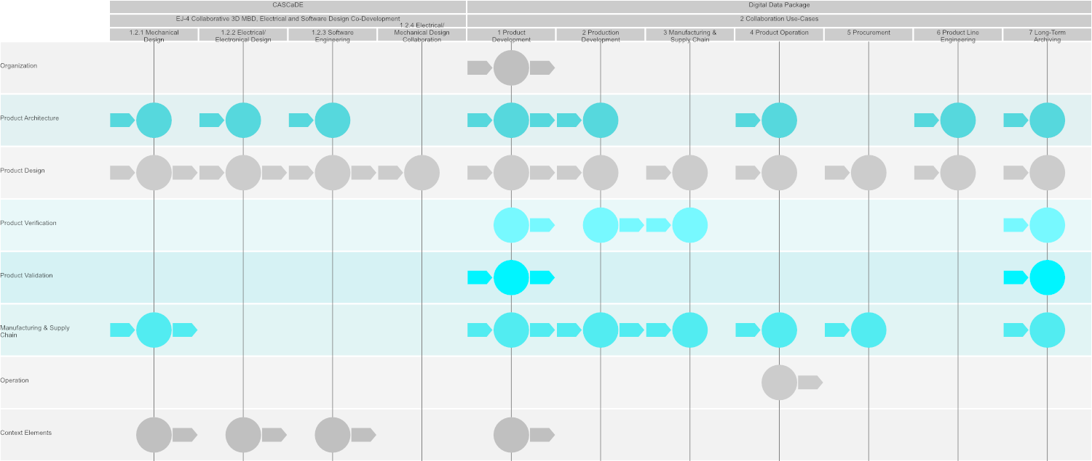
Overview: Use-Cases & Information Flow

Slide 13
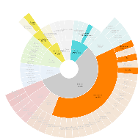
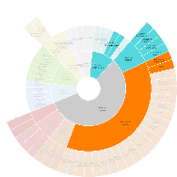
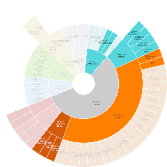
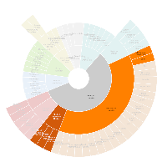
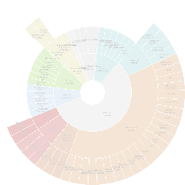
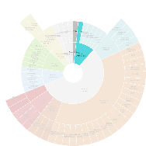

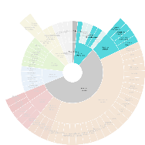
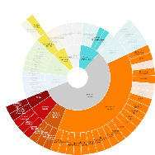
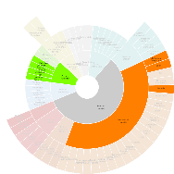
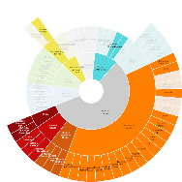

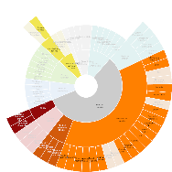
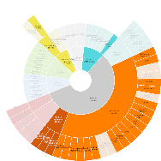
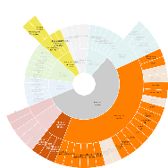
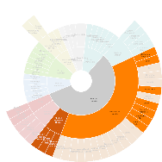
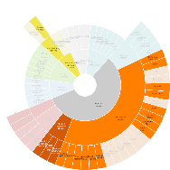
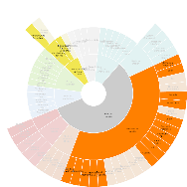
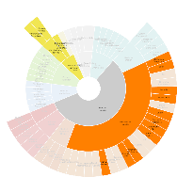
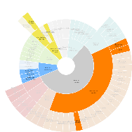
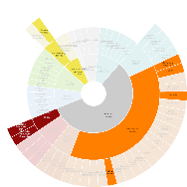
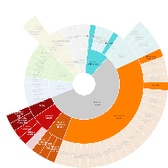
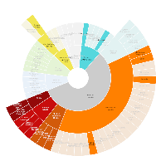
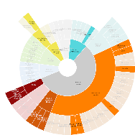
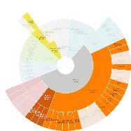
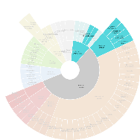
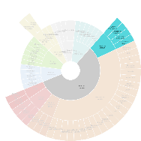
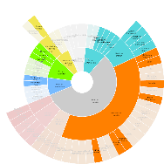
DDP Use Cases – Required input
1.2.1.1 Define Joining Elements
1.2.2 Electrical/Electronical Design
1.2.3 Software Engineering
1.2.4 Electrical/Mechanical Design Collaboration
1.1.1 Business or Mission Analysis
1.1.2 Requirements Engineering
1.1.3 Systems Architecture
1.1.4 Functional Safety
1.3.1 Plan and prepare Simulation
1.3.2 Perform and document Simulation
1.4.1 Prepare Testing
1.4.2 Perform and document Testing
2.1 Process Planning
2.2 Inspection Planning
2.3 Cost Calculation
2.4 Plant Layout
2.5 Tools & Equipment Design
3.1 Parts Manufacturing
3.2 Product Assembly
3.3 Quality Inspection
3.4 Packaging & Logistics
4.1 Product Usage
4.2 Maintenance & Service
4.3 Disassembly & Recycling
5 Procurement
6.1 Design product line
6.2 Design product asset instance
6.3 Definition product asset instance configurability space
7 Long-Term Archiving

Slide 14

◆ > CASCaDE – Required Input

Slide 15
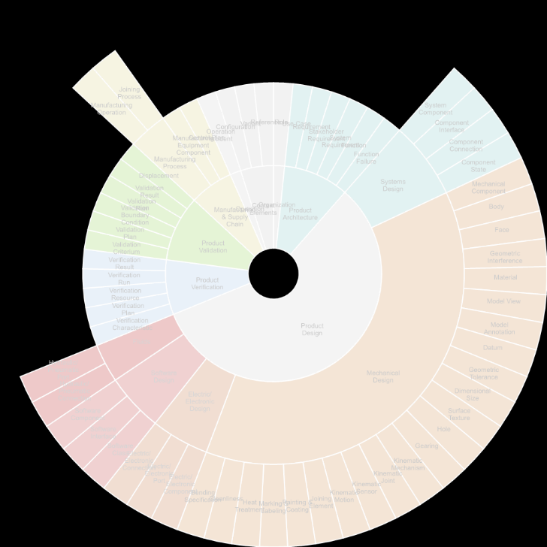
◆ > CASCaDE > EJ-4 Collaborative 3D MBD, Electrical and Software Design Co-Development – Required Input
Establish method and tool to collaboratively develop and manage 3D MBD and E-BOM connected to the Requirements, Functional and Logical Archtecture (L-BOM)

Slide 16
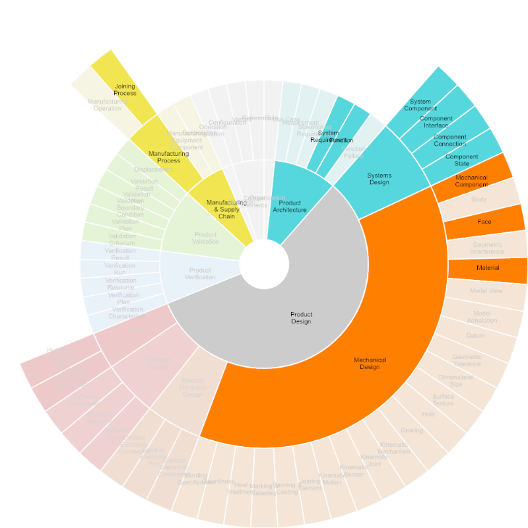

◆ > CASCaDE > EJ-4 Collaborative 3D MBD, Electrical and Software Design Co-Development > 1.2.1 Mechanical Design – Required Input
In Mechanical Design, physical product structure, product geometry, as well as all specifications are defined. This includes shape, dimensioning and tolerancing, material (including semi-finished parts and treatment), surface and edge specifications. Mechanical design is usually conducted using a mechanical CAD system.

Slide 17
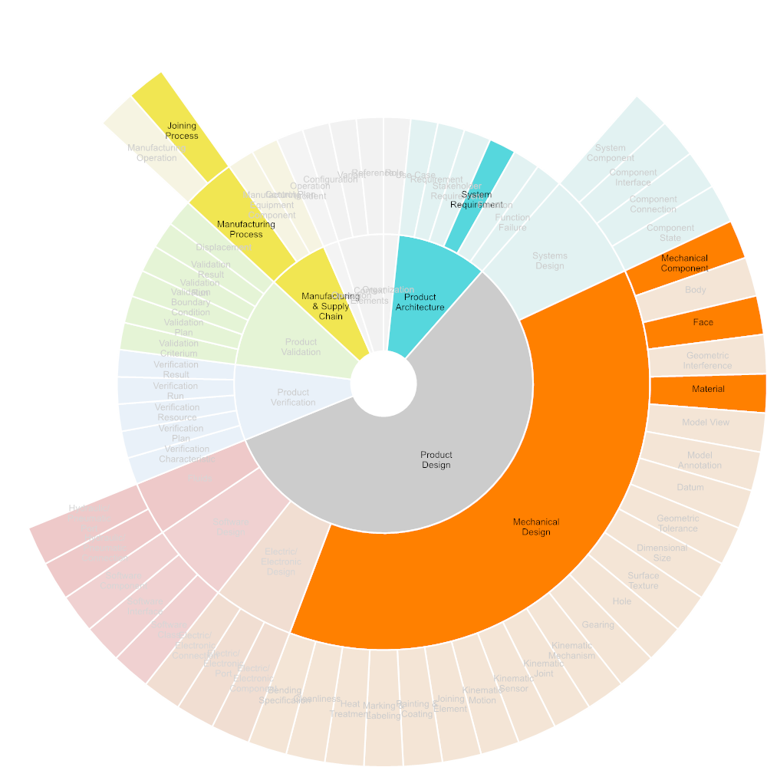
◆ > CASCaDE > EJ-4 Collaborative 3D MBD, Electrical and Software Design Co-Development > 1.2.1 Mechanical Design > 1.2.1.1 Define Joining Elements
Description
Roles
Generic Use Cases
Specific Use Cases
Tools
Inputs | System Requirement, Mechanical Component, Face, Material, Joining Process
Outputs | Joining Element

Slide 18
◆ > CASCaDE > EJ-4 Collaborative 3D MBD, Electrical and Software Design Co-Development > 1.2.1 Mechanical Design > 1.2.1.1 Define Joining Elements
Product Architecture
System Requirement
Product Design
Mechanical Design
Mechanical Component
1.2.1.1 Define Joining Elements
Joining Element
Face
Material
Manufacturing & Supply Chain
Manufacturing Process
Joining Process

Slide 19
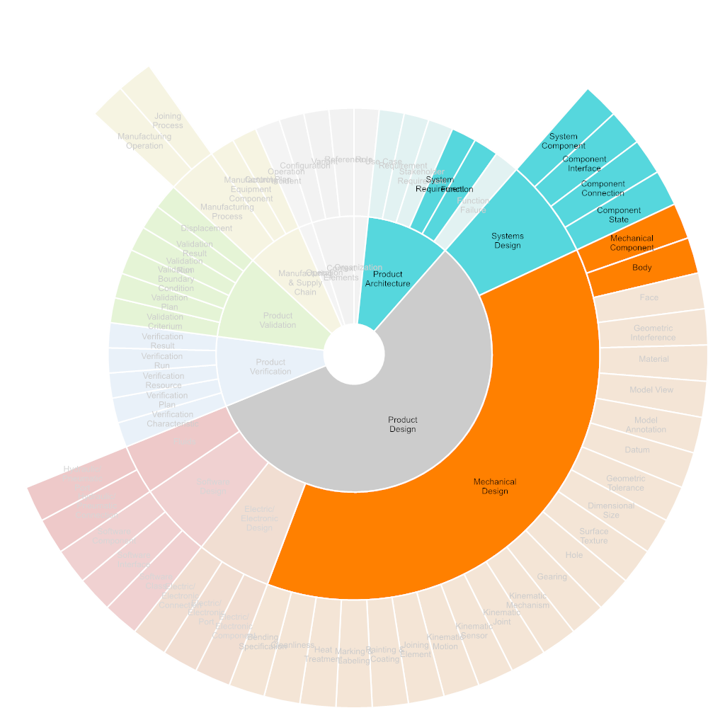
◆ > CASCaDE > EJ-4 Collaborative 3D MBD, Electrical and Software Design Co-Development > 1.2.2 Electrical/Electronical Design
Description | In Electrical/Electronic Design, all electrical and electronic products functions will be implemented through electrical and electonic components selection and allocation, circuit board design, and wire and harness routing. Electrical/Electronic Design is usually performed using an electrical/electronic CAD system.
Roles
Generic Use Cases
Specific Use Cases
Tools | ECAD Systems, PDM Systems
Inputs | System Requirement, Function, System Component, Component Interface, Component Connection, Component State, Mechanical Component, Body
Outputs | Electric/Electronic Component, Electric/Electronic Port, Electric/Electronic Connection, Configuration, Variant, Reference

Slide 20
◆ > CASCaDE > EJ-4 Collaborative 3D MBD, Electrical and Software Design Co-Development > 1.2.2 Electrical/Electronical Design
Product Architecture
Product Design
System Requirement
Electric/Electronic Design
Function
Product Design
Electric/Electronic Component
Systems Design
Electric/Electronic Port
System Component
1.2.2 Electrical/Electronical Design
Component Interface
Electric/Electronic Connection
Component Connection
Context Elements
Component State
Configuration
Mechanical Design
Variant
Mechanical Component
Body
Reference
ECAD Systems
PDM Systems

Slide 21
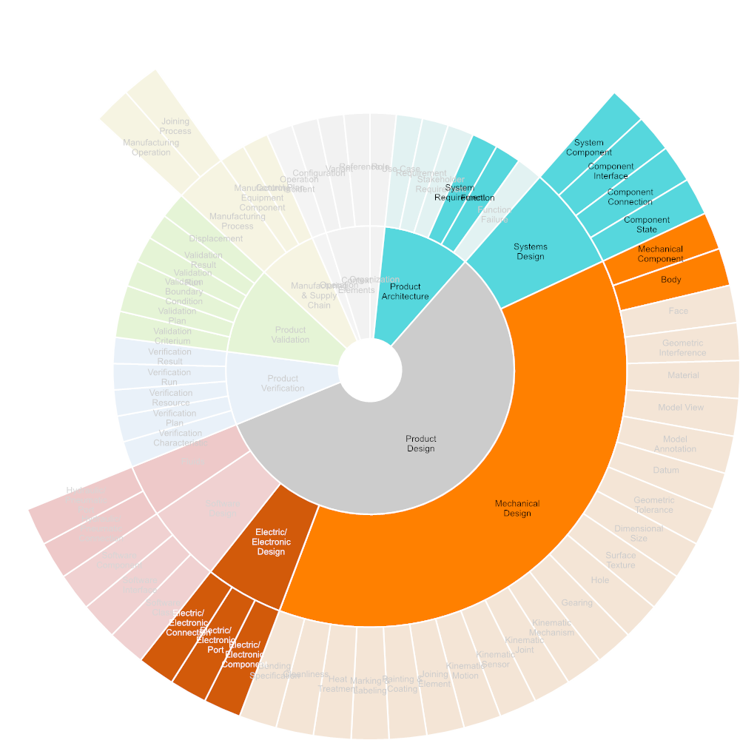
◆ > CASCaDE > EJ-4 Collaborative 3D MBD, Electrical and Software Design Co-Development > 1.2.3 Software Engineering
Description | In Software Engineering, embedded software is developed that will connect the product to the user, as well as to other products and systems. For configuration reasons it may be that software is treated a part to be considered in Bills of Material of products or systems and to be configured related to mechanical or electronic configurations of a system.
Roles
Generic Use Cases
Specific Use Cases
Tools | Software Development Tools
Inputs | System Requirement, Function, System Component, Component Interface, Component Connection, Component State, Mechanical Component, Body, Electric/Electronic Component, Electric/Electronic Port, Electric/Electronic Connection
Outputs | Software Class, Software Interface, Software Component, Configuration, Variant, Reference

Slide 22
◆ > CASCaDE > EJ-4 Collaborative 3D MBD, Electrical and Software Design Co-Development > 1.2.3 Software Engineering
Product Architecture
Product Design
System Requirement
Function
Software Design
Product Design
Software Class
Systems Design
System Component
Component Interface
Software Interface
Component Connection
1.2.3 Software Engineering
Software Component
Component State
Mechanical Design
Context Elements
Mechanical Component
Body
Configuration
Electric/Electronic Design
Electric/Electronic Component
Variant
Electric/Electronic Port
Reference
Electric/Electronic Connection
Software Development Tools

Slide 23

◆ > CASCaDE > EJ-4 Collaborative 3D MBD, Electrical and Software Design Co-Development > 1.2.4 Electrical/Mechanical Design Collaboration
Description | In Electrical/Mechanical Design Collaboration, both design disciplines involved will collaborate in a common 3D space in order to adjust and coordinate allocation, dimensioning and positioning of components.
Roles
Generic Use Cases
Specific Use Cases
Tools | ECAD Systems, MCAD Systems, PDM Systems, Publishing & Visual Collaboration
Inputs | Mechanical Component, Body, Electric/Electronic Component, Electric/Electronic Port, Electric/Electronic Connection
Outputs

Slide 24
◆ > CASCaDE > EJ-4 Collaborative 3D MBD, Electrical and Software Design Co-Development > 1.2.4 Electrical/Mechanical Design Collaboration
Mechanical Design
Mechanical Component
Body
Electric/Electronic Design
1.2.4 Electrical/Mechanical Design Collaboration
Electric/Electronic Component
Electric/Electronic Port
Electric/Electronic Connection
ECAD Systems
MCAD Systems
PDM Systems
Publishing & Visual Collaboration

Slide 25
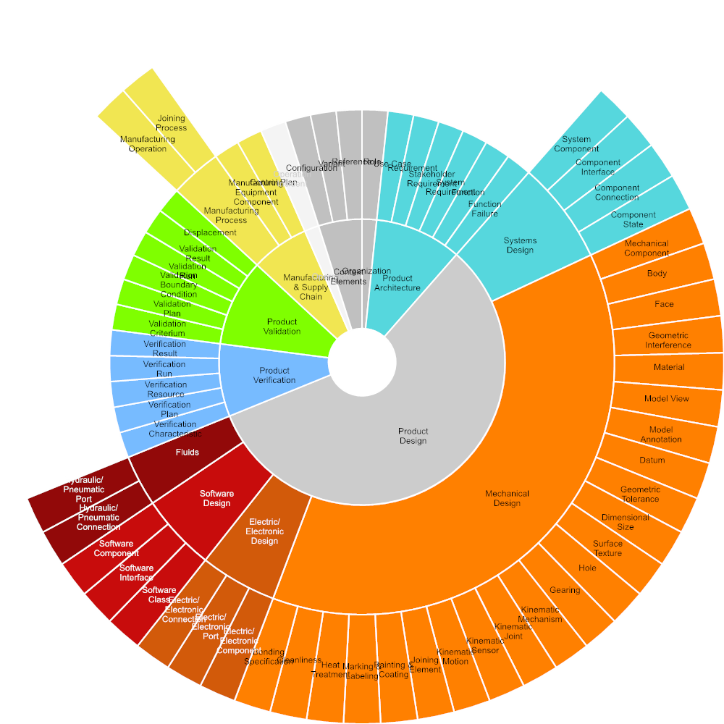
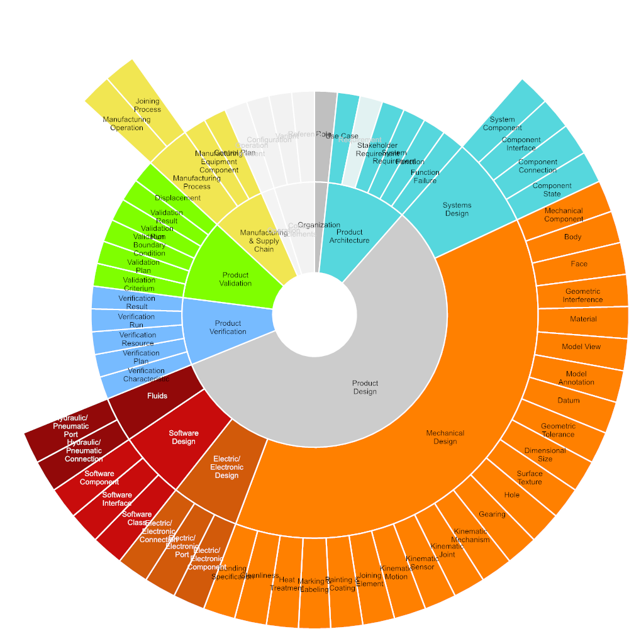
◆ > Digital Data Package – Required Input

Slide 26

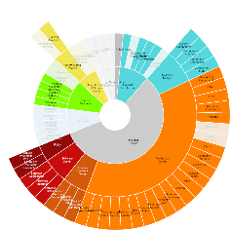

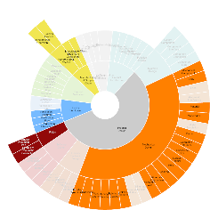
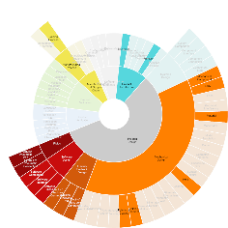



◆ > Digital Data Package > 2 Collaboration Use-Cases – Required Input
1 Product Development
2 Production Development
3 Manufacturing & Supply Chain
4 Product Operation
5 Procurement
6 Product Line Engineering
7 Long-Term Archiving

Slide 27
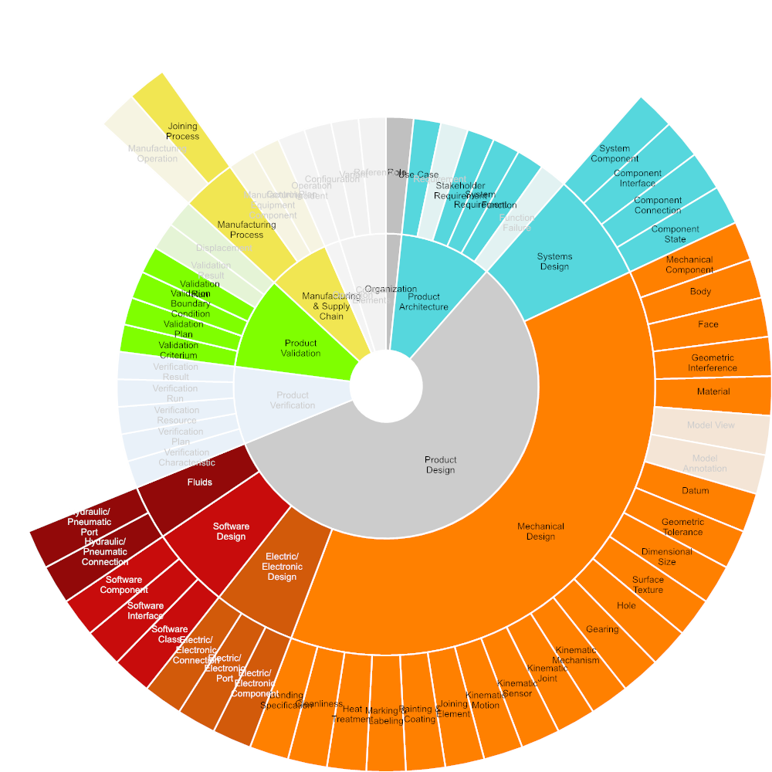

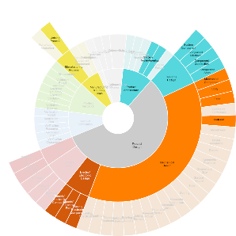
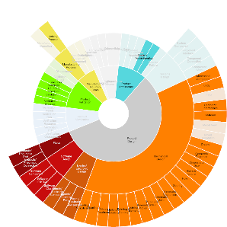

◆ > Digital Data Package > 2 Collaboration Use-Cases > 1 Product Development – Required Input
Product development is the creation of products with new or modified characteristics that offer new or additional benefits to the customer, or comply with new or changed standards, rules and regulations. Product development may involve modification of an existing product or its presentation or formulation of an entirely new product that satisfies a newly-defined or changed customer need or market segment. Description based on: https://cio-wiki.org/wiki/Product_Development
1.1 Concept definition
1.2 Product Design
1.3 Verification & Validation using Simulation
1.4 Verification & Validation using Test

Slide 28





◆ > Digital Data Package > 2 Collaboration Use-Cases > 1 Product Development > 1.1 Concept definition – Required Input
In conceptual design, new products or systems are defined through requirements and specified through a functional structure in mechanical, electrics/electronics, and software domains. A logical structure specifies the future product architecture in order to implement the specified functions. Besides new products, existing products may be changed or modified significantly to better comply with customer needs, or to attract new customers. Eventually, the product may be changed or adopted to comply to new standards, regulations or laws. Conceptual design is usually performed at a high abstraction level and low level of detail, using parameter studies, system models, and rough geometry, if any. For the Digital Data Package, model-based methods and data for product conceptual design are assumed.
1.1.1 Business or Mission Analysis
1.1.2 Requirements Engineering
1.1.3 Systems Architecture
1.1.4 Functional Safety

Slide 29

◆ > Digital Data Package > 2 Collaboration Use-Cases > 1 Product Development > 1.1 Concept definition > 1.1.1 Business or Mission Analysis
Description | Product Planning is the ongoing process of identifying and articulating market requirements that define a product's feature set. Product planning serves as the basis for decisions about price, distribution and promotion. Product planning is the process of creating a product idea and following through on it until the product is introduced to the market. Additionally, a small company must have an exit strategy for its product in case the product does not sell. Product planning entails managing the product throughout its life using various marketing strategies, including product extensions or improvements, increased distribution, price changes and promotions. Also includes the identification of relevant legal requirements as well as customs and tax regulations applicable to the product and the respective target markets. Description based on: https://en.wikipedia.org/wiki/Product_planning
Roles
Generic Use Cases
Specific Use Cases
Tools
Inputs
Outputs | Role, Use Case

Slide 30
◆ > Digital Data Package > 2 Collaboration Use-Cases > 1 Product Development > 1.1 Concept definition > 1.1.1 Business or Mission Analysis
CSA ISO/IEC/IEEE 15288 System life cycle processes System life cycle processes (Adopted ISO/IEC/IEEE 15288:2015, first edition, 2015-05-15) 2016-12-0 aktuell
Organization
Role
1.1.1 Business or Mission Analysis
Product Architecture
Use Case

Slide 31
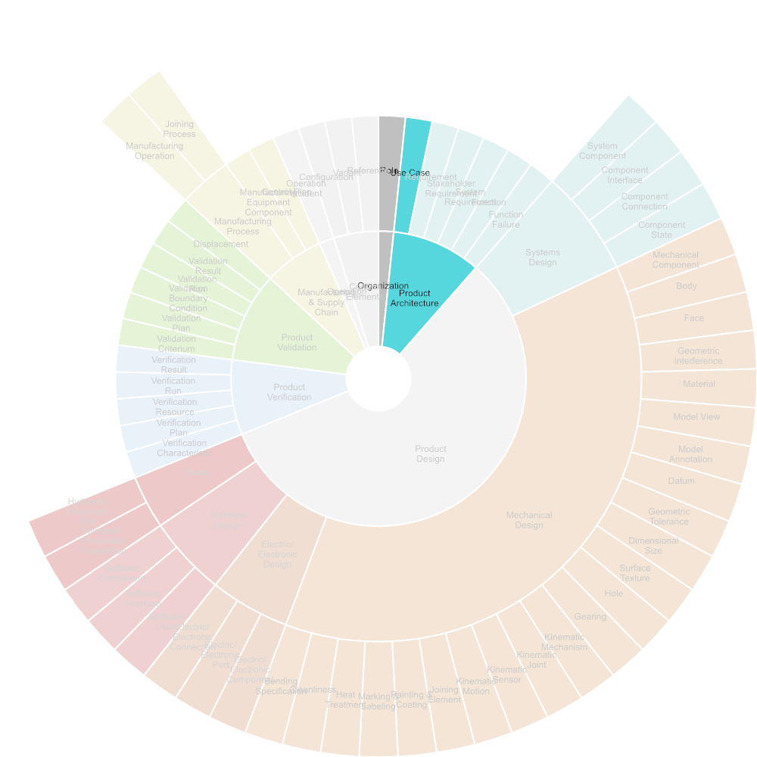
◆ > Digital Data Package > 2 Collaboration Use-Cases > 1 Product Development > 1.1 Concept definition > 1.1.2 Requirements Engineering
Description | Requirements engineering is the process of defining, eliciting, documenting, and maintaining requirements in the engineering design process. Description based on: https://en.wikipedia.org/wiki/Requirements_engineering
Roles
Generic Use Cases
Specific Use Cases
Tools | Requirements Engineering Tools
Inputs | Role, Use Case
Outputs | Requirement

Slide 32
◆ > Digital Data Package > 2 Collaboration Use-Cases > 1 Product Development > 1.1 Concept definition > 1.1.2 Requirements Engineering
Organization
Role
1.1.2 Requirements Engineering
Requirement
Product Architecture
Use Case
Requirements Engineering Tools

Slide 33

◆ > Digital Data Package > 2 Collaboration Use-Cases > 1 Product Development > 1.1 Concept definition > 1.1.3 Systems Architecture
Description | Systems architecture refers to the cross-domain definition of functions and logical structures at systems level, that will be pursued in detail by the individual domains mechanical design, electric/electronic design and software design.
Roles
Generic Use Cases
Specific Use Cases
Tools | Systems Modeling Tools
Inputs | Role, Use Case, Stakeholder Requirement
Outputs | Function, Function Failure, System Component, Component Interface, Component Connection, Component State

Slide 34
◆ > Digital Data Package > 2 Collaboration Use-Cases > 1 Product Development > 1.1 Concept definition > 1.1.3 Systems Architecture
Product Architecture
Organization
Function
Function Failure
Role
Product Design
Product Architecture
1.1.3 Systems Architecture
Systems Design
System Component
Use Case
Component Interface
Stakeholder Requirement
Component Connection
Component State
Systems Modeling Tools

Slide 35
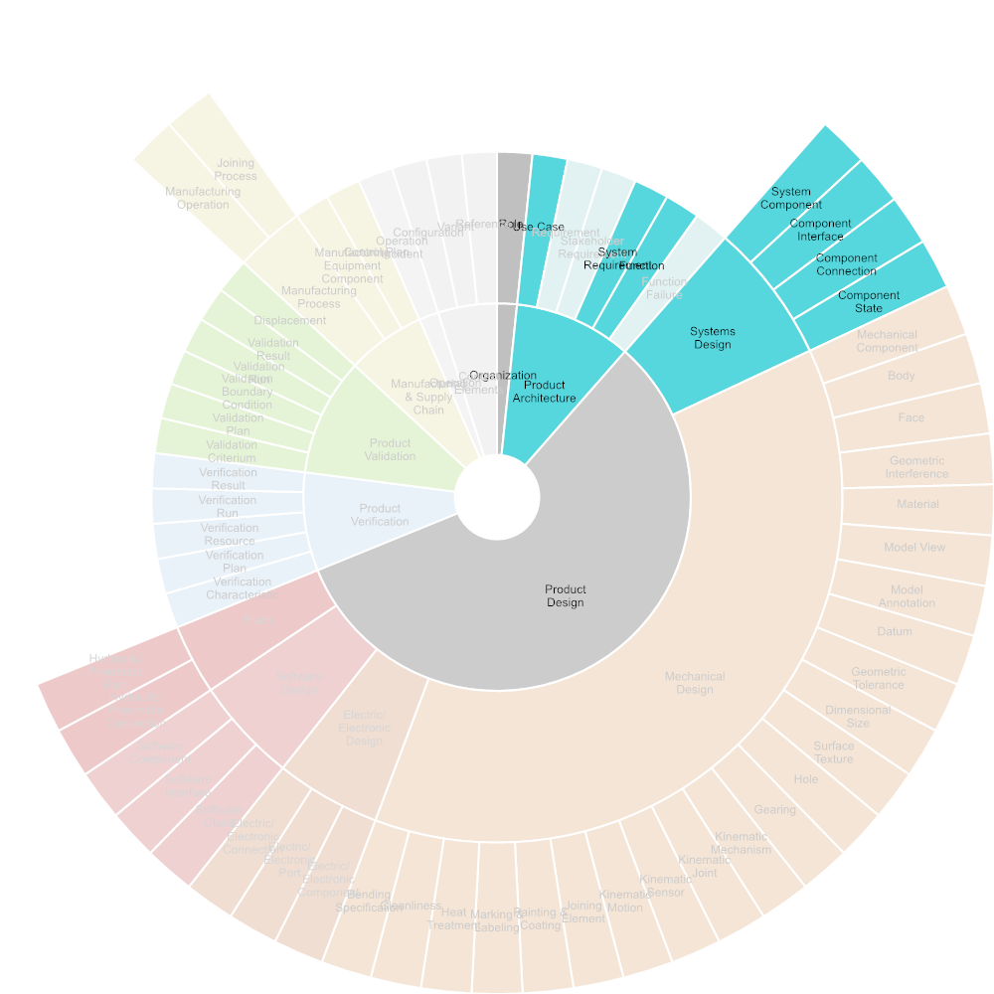
◆ > Digital Data Package > 2 Collaboration Use-Cases > 1 Product Development > 1.1 Concept definition > 1.1.4 Functional Safety
Description
Roles
Generic Use Cases
Specific Use Cases
Tools
Inputs | Role, Use Case, System Requirement, Function, System Component, Component Interface, Component Connection, Component State
Outputs | Function, Function Failure, System Component, Component Interface, Component Connection, Component State

Slide 36
◆ > Digital Data Package > 2 Collaboration Use-Cases > 1 Product Development > 1.1 Concept definition > 1.1.4 Functional Safety
Organization
Product Architecture
Role
Function
Product Architecture
Use Case
Function Failure
System Requirement
Product Design
Function
1.1.4 Functional Safety
Systems Design
Product Design
Systems Design
System Component
System Component
Component Interface
Component Interface
Component Connection
Component Connection
Component State
Component State

Slide 37
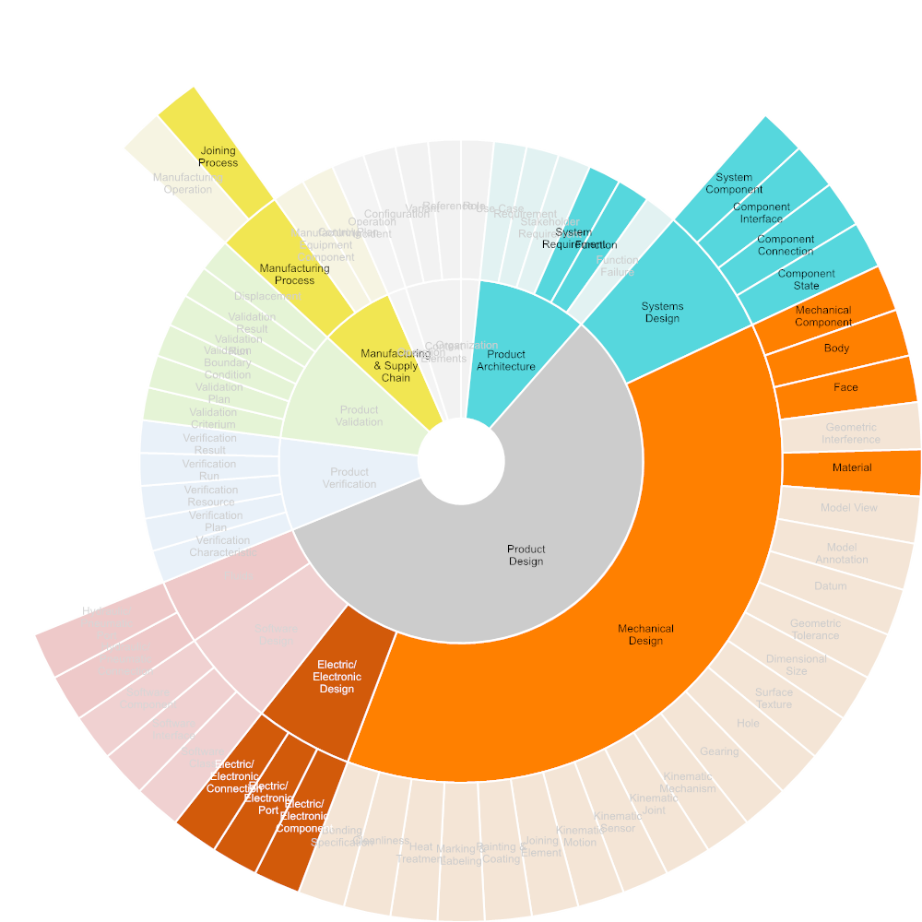
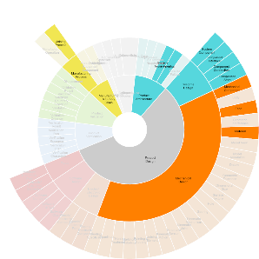



◆ > Digital Data Package > 2 Collaboration Use-Cases > 1 Product Development > 1.2 Product Design – Required Input
Product Design is the specific synthesis, implentation and documentation of design solutions suggested by systems engineering. Product design comprises the domain-specific design processes of mechanical, electrical/electronical design, and software engineering.
1.2.1 Mechanical Design
1.2.2 Electrical/Electronical Design
1.2.3 Software Engineering
1.2.4 Electrical/Mechanical Design Collaboration

Slide 38
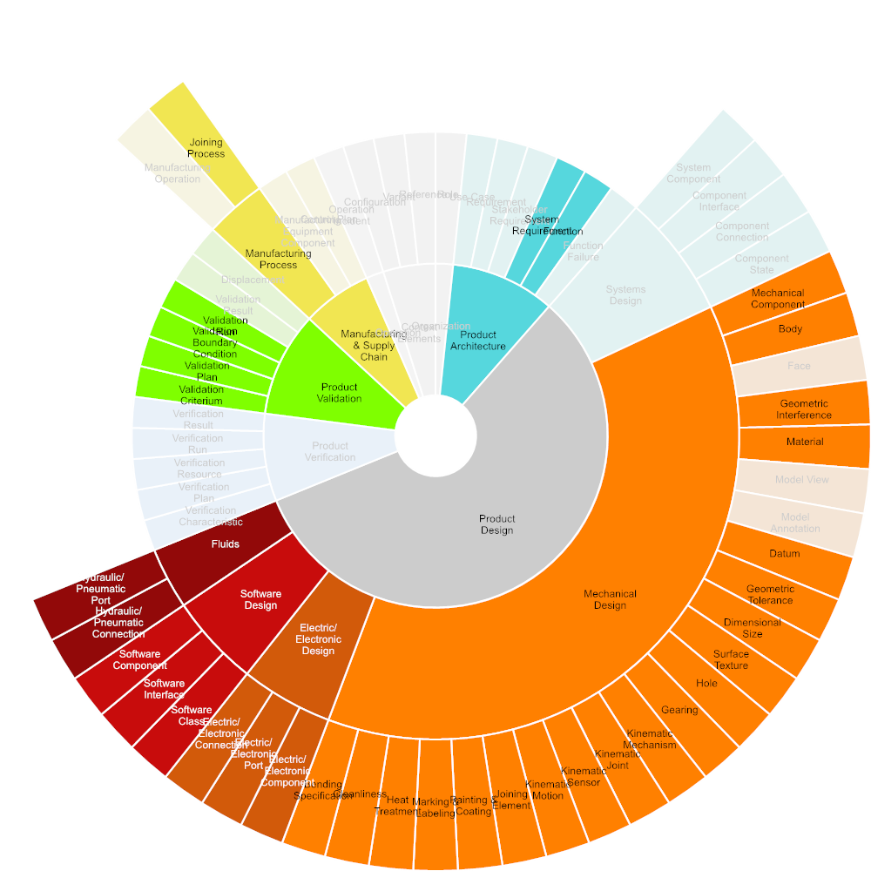


◆ > Digital Data Package > 2 Collaboration Use-Cases > 1 Product Development > 1.3 Verification & Validation using Simulation – Required Input
Modeling and simulation (M&S) is the domain-specific use of models (e.g., physical, mathematical, or logical representation of a system, entity, phenomenon, or process) as a basis for simulations to develop data utilized for management or technical decision making. Simulation may include finite elements analysis, fluid analysis, DMU simulation, kinematics simulation, as well as simulation based on software prototypes. It also includes X-in-the-Loop (XiL), using integrated design and simulation models and capabilities. Verification aims at the demonstration of product compliance to the specified design requirements. Validation aims at the demonstration of conformance to stakeholder requirements. Description based on: https://en.wikipedia.org/wiki/Modeling_and_simulation, ISO 29148, ISO 15288
1.3.1 Plan and prepare Simulation
1.3.2 Perform and document Simulation

Slide 39
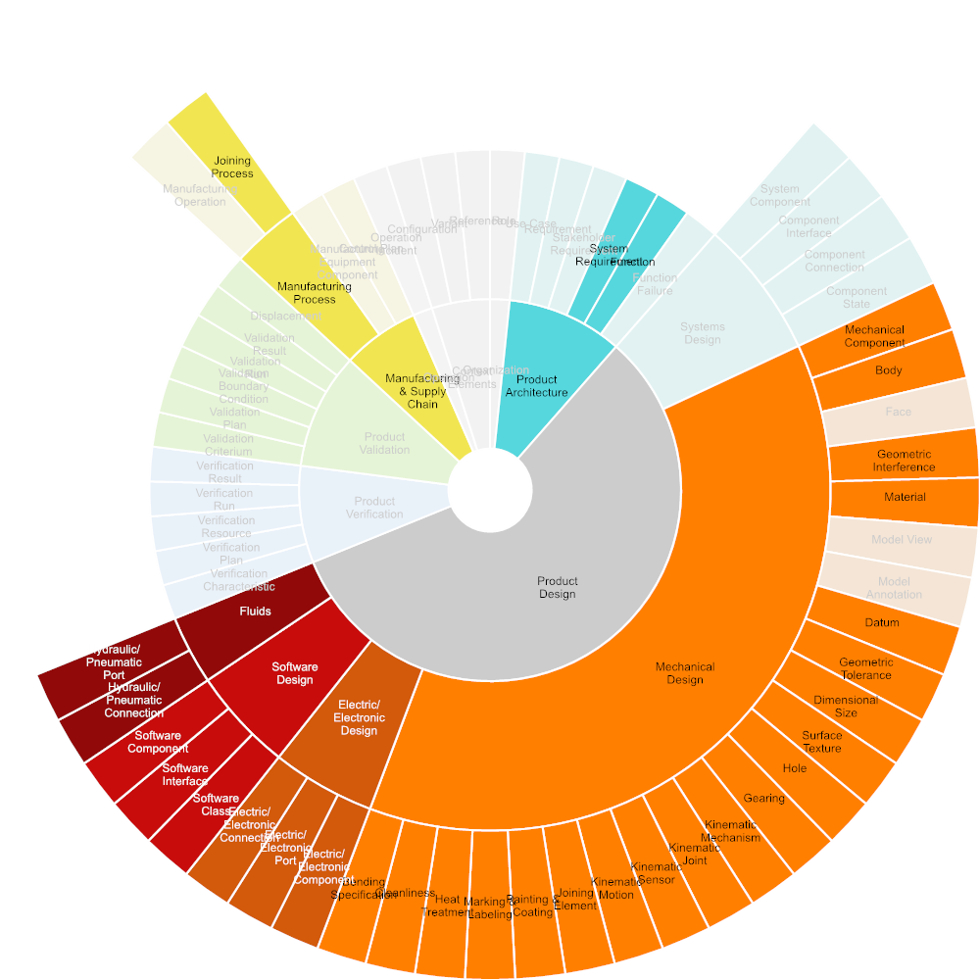
◆ > Digital Data Package > 2 Collaboration Use-Cases > 1 Product Development > 1.3 Verification & Validation using Simulation > 1.3.1 Plan and prepare Simulation
Description | Planning and preparation of a simulation includes the specification of the simulation objectives based on product requirements and functions. This is followed by the definition of the simulation boundary conditions and the createion of simulation models according to simulation objectives.
Roles
Generic Use Cases
Specific Use Cases
Tools | Analysis, Simulation & Synthesis Tools, PDM Systems, Simulation & Test Data Management Tools
Inputs | System Requirement, Function, Mechanical Component, Body, Geometric Interference, Material, Datum, Geometric Tolerance, Dimensional Size, Surface Texture, Hole, Gearing, Kinematic Mechanism, Kinematic Joint, Kinematic Sensor, Kinematic Motion, Joining Element, Painting & Coating, Marking & Labeling, Heat Treatment, Cleanliness, Bending Specification, Electric/Electronic Component, Electric/Electronic Port, Electric/Electronic Connection, Software Class, Software Interface, Software Component, Hydraulic/Pneumatic Connection, Hydraulic/Pneumatic Port, Joining Process
Outputs | Verification Characteristic, Verification Plan, Verification Resource, Validation Criterium, Validation Plan, Validation Boundary Condition

Slide 40
◆ > Digital Data Package > 2 Collaboration Use-Cases > 1 Product Development > 1.3 Verification & Validation using Simulation > 1.3.1 Plan and prepare Simulation
Product Architecture
Product Verification
System Requirement
Function
Product Design
Mechanical Design
Mechanical Component
Verification Characteristic
Body
Geometric Interference
Material
Datum
Verification Plan
Geometric Tolerance
Dimensional Size
Surface Texture
Hole
Gearing
Verification Resource
Kinematic Mechanism
Kinematic Joint
1.3.1 Plan and prepare Simulation
Kinematic Sensor
Kinematic Motion
Joining Element
Product Validation
Painting & Coating
Marking & Labeling
Heat Treatment
Cleanliness
Bending Specification
Validation Criterium
Electric/Electronic Design
Electric/Electronic Component
Electric/Electronic Port
Electric/Electronic Connection
Software Design
Validation Plan
Software Class
Software Interface
Software Component
Fluids
Hydraulic/Pneumatic Connection
Validation Boundary Condition
Hydraulic/Pneumatic Port
Manufacturing & Supply Chain
Manufacturing Process
Joining Process
Analysis, Simulation & Synthesis Tools
PDM Systems
Simulation & Test Data Management Tools

Slide 41
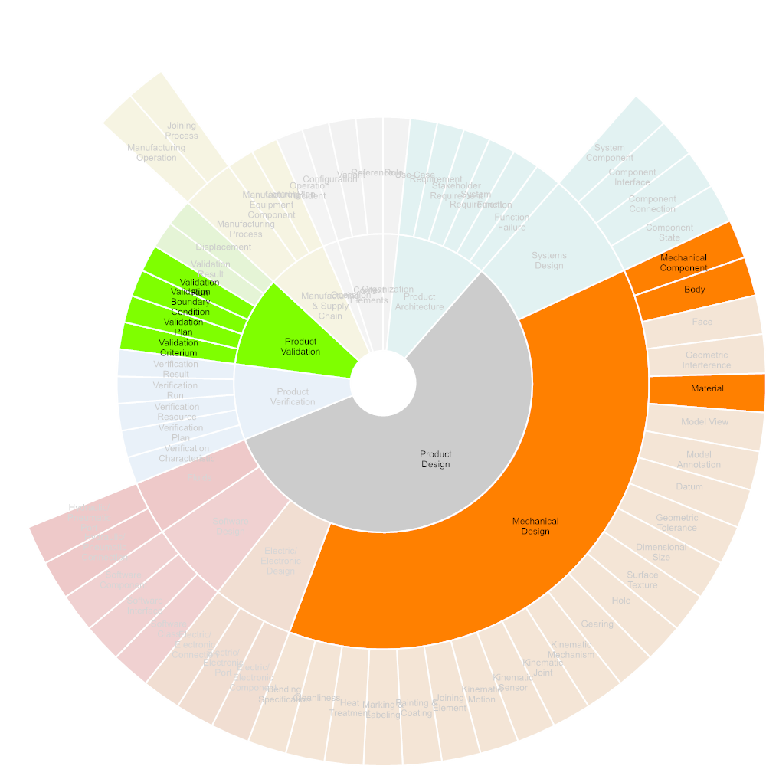
◆ > Digital Data Package > 2 Collaboration Use-Cases > 1 Product Development > 1.3 Verification & Validation using Simulation > 1.3.2 Perform and document Simulation
Description | Simulation execution includes performing the simulation as well as documenting and summarizing the simulation results.
Roles
Generic Use Cases
Specific Use Cases
Tools | Analysis, Simulation & Synthesis Tools, Simulation & Test Data Management Tools
Inputs | Mechanical Component, Body, Material, Validation Criterium, Validation Plan, Validation Boundary Condition, Validation Run
Outputs | Verification Run, Verification Result, Validation Run, Validation Result

Slide 42
◆ > Digital Data Package > 2 Collaboration Use-Cases > 1 Product Development > 1.3 Verification & Validation using Simulation > 1.3.2 Perform and document Simulation
Product Design
Product Verification
Mechanical Design
Mechanical Component
Verification Run
Body
Verification Result
Material
1.3.2 Perform and document Simulation
Product Validation
Product Validation
Validation Criterium
Validation Run
Validation Plan
Validation Boundary Condition
Validation Result
Validation Run
Analysis, Simulation & Synthesis Tools
Simulation & Test Data Management Tools

Slide 43



◆ > Digital Data Package > 2 Collaboration Use-Cases > 1 Product Development > 1.4 Verification & Validation using Test – Required Input
While simulation is based on virtual models, testing is based on prototypes and samples. Verification is to demonstrate product compliance to the specified design requirements. Validation is to demonstrate conformance to stakeholder requirements. Description based on ISO 29148, resp. ISO 15288
1.4.1 Prepare Testing
1.4.2 Perform and document Testing

Slide 44
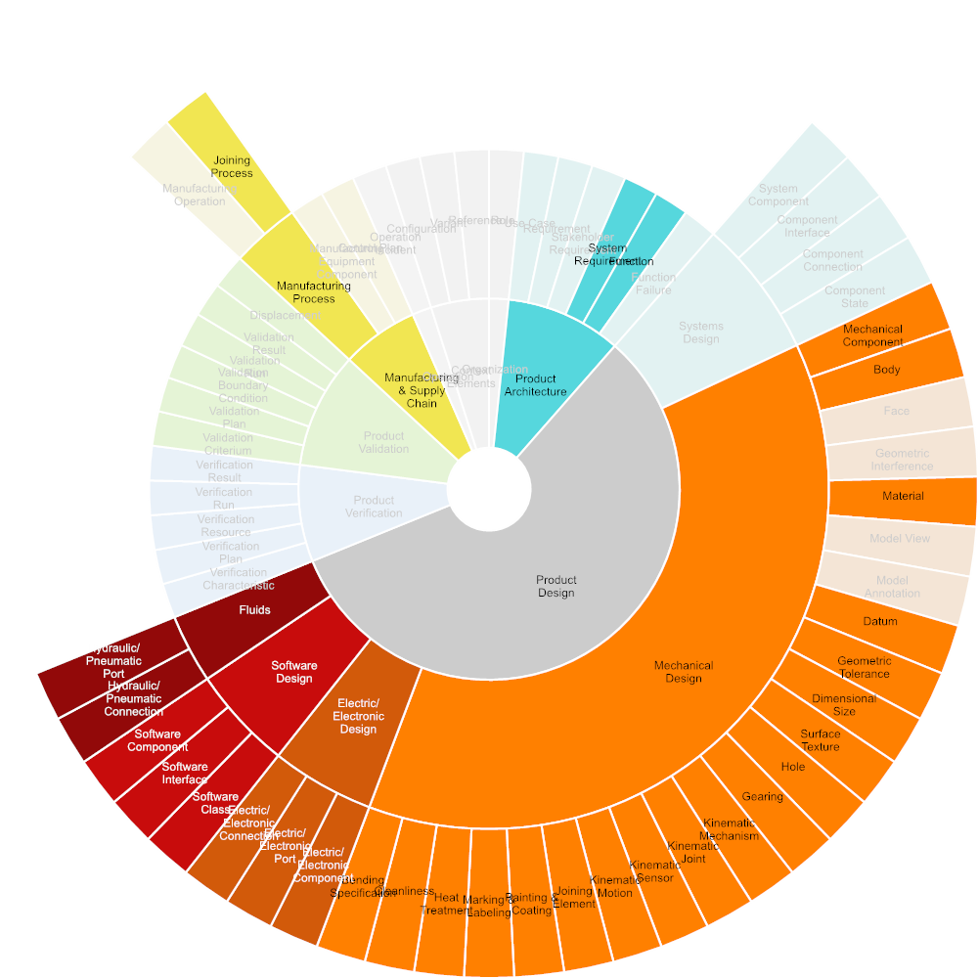
◆ > Digital Data Package > 2 Collaboration Use-Cases > 1 Product Development > 1.4 Verification & Validation using Test > 1.4.1 Prepare Testing
Description | Testing preparation includes the definition of product requirements and functions to be validated, the specification, design and manufacturing of samples, prototypes and test rigs.
Roles
Generic Use Cases
Specific Use Cases
Tools | ECAD Systems, MCAD Systems, PDM Systems, Simulation & Test Data Management Tools, Software Development Tools
Inputs | System Requirement, Function, Mechanical Component, Body, Material, Datum, Geometric Tolerance, Dimensional Size, Surface Texture, Hole, Gearing, Kinematic Mechanism, Kinematic Joint, Kinematic Sensor, Kinematic Motion, Joining Element, Painting & Coating, Marking & Labeling, Heat Treatment, Cleanliness, Bending Specification, Electric/Electronic Component, Electric/Electronic Port, Electric/Electronic Connection, Software Class, Software Interface, Software Component, Hydraulic/Pneumatic Connection, Hydraulic/Pneumatic Port, Joining Process
Outputs | Verification Characteristic, Verification Plan, Verification Resource, Validation Criterium, Validation Plan, Validation Boundary Condition

Slide 45
◆ > Digital Data Package > 2 Collaboration Use-Cases > 1 Product Development > 1.4 Verification & Validation using Test > 1.4.1 Prepare Testing
Product Architecture
Product Verification
System Requirement
Function
Product Design
Mechanical Design
Verification Characteristic
Mechanical Component
Body
Material
Datum
Geometric Tolerance
Verification Plan
Dimensional Size
Surface Texture
Hole
Gearing
Kinematic Mechanism
Verification Resource
Kinematic Joint
Kinematic Sensor
1.4.1 Prepare Testing
Kinematic Motion
Joining Element
Painting & Coating
Product Validation
Marking & Labeling
Heat Treatment
Cleanliness
Bending Specification
Validation Criterium
Electric/Electronic Design
Electric/Electronic Component
Electric/Electronic Port
Electric/Electronic Connection
Software Design
Validation Plan
Software Class
Software Interface
Software Component
Fluids
Hydraulic/Pneumatic Connection
Validation Boundary Condition
Hydraulic/Pneumatic Port
Manufacturing & Supply Chain
Manufacturing Process
Joining Process
ECAD Systems
MCAD Systems
PDM Systems
Simulation & Test Data Management Tools
Software Development Tools

Slide 46

◆ > Digital Data Package > 2 Collaboration Use-Cases > 1 Product Development > 1.4 Verification & Validation using Test > 1.4.2 Perform and document Testing
Description | Testing execution includes scheduling tests, allocating the test rig, executing and documenting the test.
Roles
Generic Use Cases
Specific Use Cases
Tools | Simulation & Test Data Management Tools
Inputs | Mechanical Component, Material, Validation Criterium, Validation Plan, Validation Boundary Condition, Validation Run
Outputs | Verification Run, Verification Result, Validation Run, Validation Result

Slide 47
◆ > Digital Data Package > 2 Collaboration Use-Cases > 1 Product Development > 1.4 Verification & Validation using Test > 1.4.2 Perform and document Testing
Product Design
Product Verification
Mechanical Design
Mechanical Component
Verification Run
Material
Verification Result
Product Validation
1.4.2 Perform and document Testing
Product Validation
Validation Criterium
Validation Plan
Validation Run
Validation Boundary Condition
Validation Result
Validation Run
Simulation & Test Data Management Tools

Slide 48
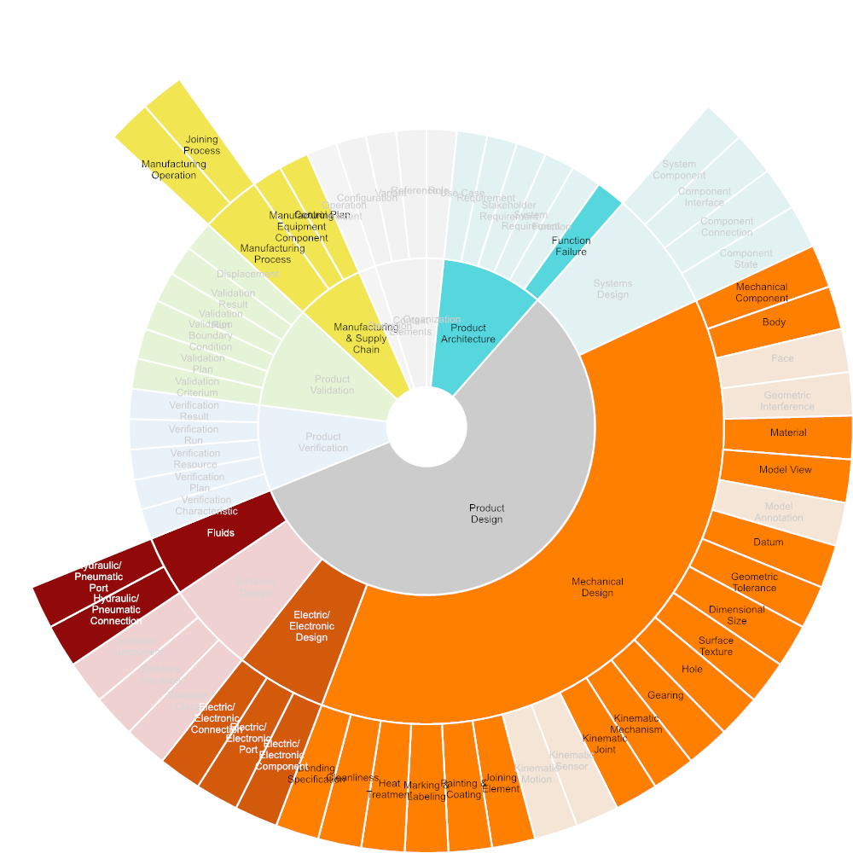



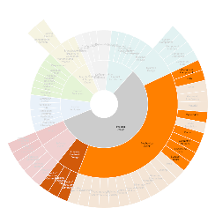

◆ > Digital Data Package > 2 Collaboration Use-Cases > 2 Production Development – Required Input
The manufacturing or production engineer's primary focus is to turn raw material into an updated or new product in the most effective, efficient & economic way possible. Manufacturing Engineering is based on core industrial engineering and mechanical engineering skills, adding important elements from mechatronics, commerce, economics and business management. Source: https://en.wikipedia.org/wiki/Manufacturing_engineering
2.1 Process Planning
2.2 Inspection Planning
2.3 Cost Calculation
2.4 Plant Layout
2.5 Tools & Equipment Design

Slide 49

◆ > Digital Data Package > 2 Collaboration Use-Cases > 2 Production Development > 2.1 Process Planning
Description | The task in the manufacturing process planning domain is to find a plan to manufacture a set of parts. Source: https://www.cs.cmu.edu/afs/cs/project/jair/pub/volume15/ambite01a-html/node23.html
Roles
Generic Use Cases
Specific Use Cases
Tools | ERP Systems, PDM Systems, Production Planning Systems
Inputs | Mechanical Component, Body, Material, Model View, Datum, Geometric Tolerance, Dimensional Size, Surface Texture, Hole, Gearing, Kinematic Mechanism, Kinematic Joint, Joining Element, Painting & Coating, Marking & Labeling, Heat Treatment, Cleanliness, Bending Specification, Electric/Electronic Component, Electric/Electronic Port, Electric/Electronic Connection, Hydraulic/Pneumatic Connection, Hydraulic/Pneumatic Port, Joining Process
Outputs | Manufacturing Operation

Slide 50
◆ > Digital Data Package > 2 Collaboration Use-Cases > 2 Production Development > 2.1 Process Planning
Product Design
Mechanical Design
Mechanical Component
Body
Material
Model View
Datum
Geometric Tolerance
Dimensional Size
Surface Texture
Hole
Gearing
Kinematic Mechanism
2.1 Process Planning
Manufacturing Operation
Kinematic Joint
Joining Element
Painting & Coating
Marking & Labeling
Heat Treatment
Cleanliness
Bending Specification
Electric/Electronic Design
Electric/Electronic Component
Electric/Electronic Port
Electric/Electronic Connection
Fluids
Hydraulic/Pneumatic Connection
Hydraulic/Pneumatic Port
Manufacturing & Supply Chain
Manufacturing Process
Joining Process
ERP Systems
PDM Systems
Production Planning Systems

Slide 51

◆ > Digital Data Package > 2 Collaboration Use-Cases > 2 Production Development > 2.2 Inspection Planning
Description | Includes the selection of relevant inspection criteria from product and production specifications, identification and assignment of appropriate inspection methods and equipment, as well as the allocation of appropriate inspection criteria per inspection event (first-article inspection, re-qualification, inspection in production, etc.)
Roles
Generic Use Cases
Specific Use Cases
Tools | Quality Management Software, ERP Systems
Inputs | Function Failure, Mechanical Component, Body, Material, Model View, Datum, Geometric Tolerance, Dimensional Size, Surface Texture, Hole, Gearing, Kinematic Mechanism, Kinematic Joint, Joining Element, Painting & Coating, Marking & Labeling, Heat Treatment, Cleanliness, Bending Specification, Electric/Electronic Component, Electric/Electronic Port, Electric/Electronic Connection, Joining Process
Outputs | Verification Characteristic, Verification Plan, Verification Resource

Slide 52
◆ > Digital Data Package > 2 Collaboration Use-Cases > 2 Production Development > 2.2 Inspection Planning
Product Architecture
Function Failure
Product Design
Mechanical Design
Mechanical Component
Body
Material
Model View
Datum
Verification Characteristic
Geometric Tolerance
Dimensional Size
Surface Texture
Hole
2.2 Inspection Planning
Verification Plan
Gearing
Kinematic Mechanism
Kinematic Joint
Joining Element
Verification Resource
Painting & Coating
Marking & Labeling
Heat Treatment
Cleanliness
Bending Specification
Electric/Electronic Design
Electric/Electronic Component
Electric/Electronic Port
Electric/Electronic Connection
Manufacturing & Supply Chain
Manufacturing Process
Joining Process
Quality Management Software
ERP Systems

Slide 53

◆ > Digital Data Package > 2 Collaboration Use-Cases > 2 Production Development > 2.3 Cost Calculation
Description | Includes the calculation of product cost using relevant information from product and production specifications, including dimensions, material, mass, geometric & topological complexity, surface finish including paint or coatings.
Roles
Generic Use Cases
Specific Use Cases
Tools | Enterprise Product Costing Systems, ERP Systems
Inputs | Mechanical Component, Body, Material, Model View, Datum, Geometric Tolerance, Dimensional Size, Surface Texture, Hole, Gearing, Kinematic Mechanism, Kinematic Joint, Joining Element, Painting & Coating, Marking & Labeling, Heat Treatment, Cleanliness, Bending Specification, Electric/Electronic Component, Electric/Electronic Port, Electric/Electronic Connection, Manufacturing Operation, Joining Process, Manufacturing Equipment Component, Control Plan
Outputs

Slide 54
◆ > Digital Data Package > 2 Collaboration Use-Cases > 2 Production Development > 2.3 Cost Calculation
Product Design
Mechanical Design
Mechanical Component
Body
Material
Model View
Datum
Geometric Tolerance
Dimensional Size
Surface Texture
Hole
Gearing
Kinematic Mechanism
2.3 Cost Calculation
Kinematic Joint
Joining Element
Painting & Coating
Marking & Labeling
Heat Treatment
Cleanliness
Bending Specification
Electric/Electronic Design
Electric/Electronic Component
Electric/Electronic Port
Electric/Electronic Connection
Manufacturing & Supply Chain
Manufacturing Process
Manufacturing Operation
Joining Process
Manufacturing Equipment Component
Control Plan
Enterprise Product Costing Systems
ERP Systems

Slide 55

◆ > Digital Data Package > 2 Collaboration Use-Cases > 2 Production Development > 2.4 Plant Layout
Description | Defines the logical and physical layout of a production line in a plant or buiding using information from product and production specifications, including production steps, material handling, as well as the physical dimensions of product components, tools, fixtures and equipment within the topology and systems of the manufacturing site or building.
Roles
Generic Use Cases
Specific Use Cases
Tools | ERP Systems, PDM Systems, Production Planning Systems
Inputs | Mechanical Component, Body, Model View, Datum, Geometric Tolerance, Dimensional Size, Surface Texture, Electric/Electronic Component, Electric/Electronic Port, Electric/Electronic Connection
Outputs | Manufacturing Equipment Component

Slide 56
◆ > Digital Data Package > 2 Collaboration Use-Cases > 2 Production Development > 2.4 Plant Layout
Mechanical Design
Mechanical Component
Body
Model View
Datum
Geometric Tolerance
2.4 Plant Layout
Manufacturing Equipment Component
Dimensional Size
Surface Texture
Electric/Electronic Design
Electric/Electronic Component
Electric/Electronic Port
Electric/Electronic Connection
ERP Systems
PDM Systems
Production Planning Systems

Slide 57

◆ > Digital Data Package > 2 Collaboration Use-Cases > 2 Production Development > 2.5 Tools & Equipment Design
Description | The design of tools and equipment aligned with product design, the manufacturing process plan and plant layout.
Roles
Generic Use Cases
Specific Use Cases
Tools | ERP Systems, MCAD Systems, PDM Systems, Production Planning Systems
Inputs | Mechanical Component, Body, Material, Model View, Datum, Geometric Tolerance, Dimensional Size, Surface Texture, Joining Element, Painting & Coating, Marking & Labeling, Heat Treatment, Cleanliness, Bending Specification, Electric/Electronic Component, Electric/Electronic Port, Electric/Electronic Connection, Joining Process
Outputs | Manufacturing Equipment Component

Slide 58
◆ > Digital Data Package > 2 Collaboration Use-Cases > 2 Production Development > 2.5 Tools & Equipment Design
Product Design
Mechanical Design
Mechanical Component
Body
Material
Model View
Datum
Geometric Tolerance
Dimensional Size
Surface Texture
Joining Element
2.5 Tools & Equipment Design
Manufacturing Equipment Component
Painting & Coating
Marking & Labeling
Heat Treatment
Cleanliness
Bending Specification
Electric/Electronic Design
Electric/Electronic Component
Electric/Electronic Port
Electric/Electronic Connection
Manufacturing & Supply Chain
Manufacturing Process
Joining Process
ERP Systems
MCAD Systems
PDM Systems
Production Planning Systems

Slide 59





◆ > Digital Data Package > 2 Collaboration Use-Cases > 3 Manufacturing & Supply Chain – Required Input
Includes all activities related to source and manufacture a product in different companies, plants, or locations.
3.1 Parts Manufacturing
3.2 Product Assembly
3.3 Quality Inspection
3.4 Packaging & Logistics

Slide 60

◆ > Digital Data Package > 2 Collaboration Use-Cases > 3 Manufacturing & Supply Chain > 3.1 Parts Manufacturing
Description | Manufacturing of single parts using a variety of production processes and methods, each with specific sets of data, such as CNC programs, bending specification, holes specifications, joining features, etc.
Roles
Generic Use Cases
Specific Use Cases
Tools | ERP Systems, Production Planning Systems
Inputs | Mechanical Component, Body, Material, Model View, Datum, Geometric Tolerance, Dimensional Size, Surface Texture, Hole, Gearing, Painting & Coating, Marking & Labeling, Heat Treatment, Cleanliness, Bending Specification, Manufacturing Operation, Manufacturing Equipment Component
Outputs

Slide 61
◆ > Digital Data Package > 2 Collaboration Use-Cases > 3 Manufacturing & Supply Chain > 3.1 Parts Manufacturing
Product Design
Mechanical Design
Mechanical Component
Body
Material
Model View
Datum
Geometric Tolerance
Dimensional Size
Surface Texture
3.1 Parts Manufacturing
Hole
Gearing
Painting & Coating
Marking & Labeling
Heat Treatment
Cleanliness
Bending Specification
Manufacturing & Supply Chain
Manufacturing Process
Manufacturing Operation
Manufacturing Equipment Component
ERP Systems
Production Planning Systems

Slide 62

◆ > Digital Data Package > 2 Collaboration Use-Cases > 3 Manufacturing & Supply Chain > 3.2 Product Assembly
Description | Assembly of components or products from single parts or sub-components according to a production plan, using all kinds of joinig and bonding.
Roles
Generic Use Cases
Specific Use Cases
Tools | ERP Systems, Production Planning Systems
Inputs | Mechanical Component, Body, Material, Model View, Datum, Geometric Tolerance, Dimensional Size, Surface Texture, Kinematic Mechanism, Kinematic Joint, Joining Element, Manufacturing Operation, Joining Process, Manufacturing Equipment Component
Outputs

Slide 63
◆ > Digital Data Package > 2 Collaboration Use-Cases > 3 Manufacturing & Supply Chain > 3.2 Product Assembly
Product Design
Mechanical Design
Mechanical Component
Body
Material
Model View
Datum
Geometric Tolerance
Dimensional Size
3.2 Product Assembly
Surface Texture
Kinematic Mechanism
Kinematic Joint
Joining Element
Manufacturing & Supply Chain
Manufacturing Process
Manufacturing Operation
Joining Process
Manufacturing Equipment Component
ERP Systems
Production Planning Systems

Slide 64

◆ > Digital Data Package > 2 Collaboration Use-Cases > 3 Manufacturing & Supply Chain > 3.3 Quality Inspection
Description | Includes the inspection of single parts, components or products during or after the manufacturing process, as well as the documentation of inspection results.
Roles
Generic Use Cases
Specific Use Cases
Tools | Quality Management Software, ERP Systems
Inputs | Mechanical Component, Body, Joining Element, Verification Characteristic, Verification Plan, Verification Resource, Joining Process, Control Plan
Outputs

Slide 65
◆ > Digital Data Package > 2 Collaboration Use-Cases > 3 Manufacturing & Supply Chain > 3.3 Quality Inspection
Product Design
Mechanical Design
Mechanical Component
Body
Joining Element
Product Verification
3.3 Quality Inspection
Verification Characteristic
Verification Plan
Verification Resource
Manufacturing & Supply Chain
Manufacturing Process
Joining Process
Control Plan
Quality Management Software
ERP Systems

Slide 66

◆ > Digital Data Package > 2 Collaboration Use-Cases > 3 Manufacturing & Supply Chain > 3.4 Packaging & Logistics
Description | Includes the definition of all kinds of packaging and transport equipment to ensure a product or its components will be supplied to their destination safely.
Roles
Generic Use Cases
Specific Use Cases
Tools | ERP Systems, MCAD Systems, PDM Systems
Inputs | Mechanical Component, Body, Material, Joining Element, Hydraulic/Pneumatic Connection, Hydraulic/Pneumatic Port, Joining Process
Outputs

Slide 67
◆ > Digital Data Package > 2 Collaboration Use-Cases > 3 Manufacturing & Supply Chain > 3.4 Packaging & Logistics
Product Design
Mechanical Design
Mechanical Component
Body
Material
Joining Element
3.4 Packaging & Logistics
Fluids
Hydraulic/Pneumatic Connection
Hydraulic/Pneumatic Port
Manufacturing & Supply Chain
Manufacturing Process
Joining Process
ERP Systems
MCAD Systems
PDM Systems

Slide 68




◆ > Digital Data Package > 2 Collaboration Use-Cases > 4 Product Operation – Required Input
Includes all phases and activities in the operation phase of a product.
4.1 Product Usage
4.2 Maintenance & Service
4.3 Disassembly & Recycling

Slide 69

◆ > Digital Data Package > 2 Collaboration Use-Cases > 4 Product Operation > 4.1 Product Usage
Description | Usage of a product according to the designated purpose and function.
Roles
Generic Use Cases
Specific Use Cases
Tools | ERP Systems
Inputs | Use Case, Function, Mechanical Component, Material, Electric/Electronic Component, Electric/Electronic Port, Electric/Electronic Connection, Software Interface, Software Component, Hydraulic/Pneumatic Connection, Hydraulic/Pneumatic Port
Outputs | Operation Incident

Slide 70
◆ > Digital Data Package > 2 Collaboration Use-Cases > 4 Product Operation > 4.1 Product Usage
Product Architecture
Use Case
Function
Product Design
Mechanical Design
Mechanical Component
Material
Electric/Electronic Design
4.1 Product Usage
Operation Incident
Electric/Electronic Component
Electric/Electronic Port
Electric/Electronic Connection
Software Design
Software Interface
Software Component
Fluids
Hydraulic/Pneumatic Connection
Hydraulic/Pneumatic Port
ERP Systems

Slide 71

◆ > Digital Data Package > 2 Collaboration Use-Cases > 4 Product Operation > 4.2 Maintenance & Service
Description | Includes all activities performed in order to maintain a product in operation.
Roles
Generic Use Cases
Specific Use Cases
Tools | ERP Systems
Inputs | Use Case, Function, Mechanical Component, Body, Material, Joining Element, Electric/Electronic Component, Electric/Electronic Port, Electric/Electronic Connection, Software Class, Software Interface, Software Component, Hydraulic/Pneumatic Connection, Hydraulic/Pneumatic Port, Joining Process
Outputs

Slide 72
◆ > Digital Data Package > 2 Collaboration Use-Cases > 4 Product Operation > 4.2 Maintenance & Service
Product Architecture
Use Case
Function
Product Design
Mechanical Design
Mechanical Component
Body
Material
Joining Element
Electric/Electronic Design
Electric/Electronic Component
4.2 Maintenance & Service
Electric/Electronic Port
Electric/Electronic Connection
Software Design
Software Class
Software Interface
Software Component
Fluids
Hydraulic/Pneumatic Connection
Hydraulic/Pneumatic Port
Manufacturing & Supply Chain
Manufacturing Process
Joining Process
ERP Systems

Slide 73

◆ > Digital Data Package > 2 Collaboration Use-Cases > 4 Product Operation > 4.3 Disassembly & Recycling
Description | Includes all end-of-life activities required to putting a product or its component to recycling.
Roles
Generic Use Cases
Specific Use Cases
Tools | ERP Systems
Inputs | Function, Mechanical Component, Body, Material, Hole, Joining Element, Painting & Coating, Electric/Electronic Component, Electric/Electronic Port, Electric/Electronic Connection, Hydraulic/Pneumatic Connection, Hydraulic/Pneumatic Port, Joining Process
Outputs

Slide 74
◆ > Digital Data Package > 2 Collaboration Use-Cases > 4 Product Operation > 4.3 Disassembly & Recycling
Product Architecture
Function
Product Design
Mechanical Design
Mechanical Component
Body
Material
Hole
Joining Element
4.3 Disassembly & Recycling
Painting & Coating
Electric/Electronic Design
Electric/Electronic Component
Electric/Electronic Port
Electric/Electronic Connection
Fluids
Hydraulic/Pneumatic Connection
Hydraulic/Pneumatic Port
Manufacturing & Supply Chain
Manufacturing Process
Joining Process
ERP Systems

Slide 75

◆ > Digital Data Package > 2 Collaboration Use-Cases > 5 Procurement
Description | Communication between procurement and suppliers in the bidding and iquiry phase. Supports the OMG Model-Based Aqcuisition initiative.
Roles
Generic Use Cases
Specific Use Cases
Tools | Enterprise Product Costing Systems, ERP Systems, Publishing & Visual Collaboration
Inputs | Mechanical Component, Body, Material, Datum, Geometric Tolerance, Dimensional Size, Surface Texture, Hole, Gearing, Joining Element, Painting & Coating, Marking & Labeling, Heat Treatment, Cleanliness, Bending Specification, Electric/Electronic Component, Electric/Electronic Port, Electric/Electronic Connection, Joining Process
Outputs

Slide 76
◆ > Digital Data Package > 2 Collaboration Use-Cases > 5 Procurement
Product Design
Mechanical Design
Mechanical Component
Body
Material
Datum
Geometric Tolerance
Dimensional Size
Surface Texture
Hole
Gearing
5 Procurement
Joining Element
Painting & Coating
Marking & Labeling
Heat Treatment
Cleanliness
Bending Specification
Electric/Electronic Design
Electric/Electronic Component
Electric/Electronic Port
Electric/Electronic Connection
Manufacturing & Supply Chain
Manufacturing Process
Joining Process
Enterprise Product Costing Systems
ERP Systems
Publishing & Visual Collaboration

Slide 77



◆ > Digital Data Package > 2 Collaboration Use-Cases > 6 Product Line Engineering – Required Input
6.1 Design product line
6.2 Design product asset instance
6.3 Definition product asset instance configurability space

Slide 78

◆ > Digital Data Package > 2 Collaboration Use-Cases > 6 Product Line Engineering > 6.1 Design product line
Description | Definition of the “shared asset supersets” and feature catalog: this is a collaborative effort typically involving the CU architect, customer product owner and possibly supplier tech marketing team. The goal is eventually to define the product family i.e. to identify all the assets and their potential variations that can be used to provide a solution to any given problem within the target problem domain, rather than building for each problem an ad-hoc solution. The problem domain is specified by the customer/product owner, but can be typically expanded by the tech marketing team who captures requirements from other customers and push for alignment with strategic objectives. In defining the product line the CU architect is driven by objectives as costs, reuse, IPs while the product owner wants the product family to allow for a problem solution as close as possible to an “optimal” ad-hoc architecture.
Roles
Generic Use Cases
Specific Use Cases
Tools
Inputs | System Requirement, Function, System Component, Component Interface, Component Connection, Component State
Outputs

Slide 79
◆ > Digital Data Package > 2 Collaboration Use-Cases > 6 Product Line Engineering > 6.1 Design product line
Product Architecture
System Requirement
Function
Product Design
Systems Design
6.1 Design product line
System Component
Component Interface
Component Connection
Component State

Slide 80

◆ > Digital Data Package > 2 Collaboration Use-Cases > 6 Product Line Engineering > 6.2 Design product asset instance
Description | Design of the CU product asset instance, implying the definition of the bill of features: the ultimate goal of this collaboration use case is the specification of the features, selected from the feature catalogue, that define the solution to the specific customer problem within the solution/family portfolio. The bill of feature is basically the set of actual values assigned to the variation point, which fully determine a single specific family instance. Collaboration still happens between product and CU architects, with the former specifying requirements and high level architecture for a specific problem (within their problem domain) and the latter providing a set of potential solutions, all belonging to the same CU family.
Roles
Generic Use Cases
Specific Use Cases
Tools
Inputs | System Component, Component Interface, Component Connection, Component State
Outputs

Slide 81
◆ > Digital Data Package > 2 Collaboration Use-Cases > 6 Product Line Engineering > 6.2 Design product asset instance
System Component
Component Interface
6.2 Design product asset instance
Component Connection
Component State

Slide 82
◆ > Digital Data Package > 2 Collaboration Use-Cases > 6 Product Line Engineering > 6.3 Definition product asset instance configurability space
Description | Definition of the CU product asset instance configurability space: the objective is to define the set of configuration options that will be made available to the CU end user for each CU instance. Typical options available for CU include clock selection, clock speed, caching and cache policy, protocol for external bus interfaces, general purpose I/O configuration (direction, active etc.) as well as dedicated options for peripherals and co-processors. A key aspect is also the definition of the configuration mechanisms that will be made available to the user including configuration protection features to prevent undesired/unauthorized changes. This is a collaborative efforts involving the same actors as Use Case 1, though driven by different criteria. The CU architect must balance the flexibility provided by configurability options with the added complexity it typically brings in terms of hardware design as well as verification effort. The product owner must balance programming complexity, potential higher cost and lower efficiency, with the capability of having their single CU instance capable of covering a broader problem space.
Roles
Generic Use Cases
Specific Use Cases
Tools
Inputs | System Component, Component Interface, Component Connection, Component State
Outputs

Slide 83
◆ > Digital Data Package > 2 Collaboration Use-Cases > 6 Product Line Engineering > 6.3 Definition product asset instance configurability space
System Component
Component Interface
6.3 Definition product asset instance configurability space
Component Connection
Component State

Slide 84

◆ > Digital Data Package > 2 Collaboration Use-Cases > 7 Long-Term Archiving
Description | For long-term archiving, all product information must be configured and stored in a retrievable way. Product information includes domain-specifc models, relations between models and model entities, and meta-data about the documents and models.
Roles
Generic Use Cases
Specific Use Cases
Tools
Inputs | Stakeholder Requirement, System Requirement, Function, Function Failure, System Component, Component Interface, Component Connection, Component State, Mechanical Component, Body, Material, Model Annotation, Kinematic Mechanism, Kinematic Joint, Joining Element, Verification Run, Verification Result, Validation Run, Validation Result, Displacement, Joining Process
Outputs

Slide 85
◆ > Digital Data Package > 2 Collaboration Use-Cases > 7 Long-Term Archiving
Product Architecture
Stakeholder Requirement
System Requirement
Function
Function Failure
Product Design
Systems Design
System Component
Component Interface
Component Connection
Component State
Mechanical Design
Mechanical Component
7 Long-Term Archiving
Body
Material
Model Annotation
Kinematic Mechanism
Kinematic Joint
Joining Element
Product Verification
Verification Run
Verification Result
Product Validation
Validation Run
Validation Result
Displacement
Manufacturing & Supply Chain
Manufacturing Process
Joining Process

Slide 86
Organization
Role
Product Architecture
Use Case
Requirement
Stakeholder Requirement
System Requirement
Function
Function Failure
Product Design
Systems Design
System Component
Component Interface
Component Connection
Component State
Mechanical Design
Mechanical Component
Body
Face
Geometric Interference
Material
Model View
Model Annotation
Datum
Geometric Tolerance
Dimensional Size
Surface Texture
Hole
Gearing
Kinematic Mechanism
Kinematic Joint
Kinematic Sensor
Kinematic Motion
Joining Element
Painting & Coating
Marking & Labeling
Heat Treatment
Cleanliness
Bending Specification
Electric/Electronic Design
Electric/Electronic Component
Electric/Electronic Port
Electric/Electronic Connection
Software Design
Software Class
Software Interface
Software Component
Fluids
Hydraulic/Pneumatic Connection
Hydraulic/Pneumatic Port
Product Verification
Verification Characteristic
Verification Plan
Verification Resource
Verification Run
Verification Result
Product Validation
Validation Criterium
Validation Plan
Validation Boundary Condition
Validation Run
Validation Result
Displacement
Manufacturing & Supply Chain
Manufacturing Process
Manufacturing Operation
Joining Process
Manufacturing Equipment Component
Control Plan
Operation
Operation Incident
Context Elements
Configuration
Variant
Reference

Slide 87
DDP Information model
Name | Description | Created by use-case | Required by use-case | Specified by reference
Organization | Includes all entities representing a corporate or project organization
Role | A defined function to be performed by a project team member, such as testing, filing, inspecting, coding. https://intranet.prostep.org/display/PROJ/Glossary | 1.1.1 Business or Mission Analysis | 1.1.2 Requirements Engineering, 1.1.3 Systems Architecture, 1.1.4 Functional Safety
Product Architecture | Includes all entities contributing to the product architecture
Use Case | Specifies what the user of a product will do in order to achieve a goal | 1.1.1 Business or Mission Analysis | 1.1.2 Requirements Engineering, 1.1.3 Systems Architecture, 1.1.4 Functional Safety, 4.1 Product Usage, 4.2 Maintenance & Service
Requirement | Characteristics that identify the accomplishment levels needed to achieve specific objectives for a given set of conditions. Requirements can be 'must have', 'can have' and 'nice to have'. A. A condition or capability needed by a user to solve a problem or achieve an objective. B. A condition or capability that must be met or possessed by a system or system component to satisfy a contract, standard, specification, or other formally imposed document. C. A documented representation of a condition or capability as in definition (A:) or (B). https://intranet.prostep.org/display/PROJ/Glossary | 1.1.2 Requirements Engineering |  | CSA ISO/IEC/IEEE 15288 System life cycle processes System life cycle processes (Adopted ISO/IEC/IEEE 15288:2015, first edition, 2015-05-15) 2016-12-0 aktuell

Slide 88
DDP Information model
Name | Description | Created by use-case | Required by use-case | Specified by reference
Stakeholder Requirement |  |  | 1.1.3 Systems Architecture, 7 Long-Term Archiving | CSA ISO/IEC/IEEE 15288 System life cycle processes System life cycle processes (Adopted ISO/IEC/IEEE 15288:2015, first edition, 2015-05-15) 2016-12-0 aktuell
System Requirement |  |  | 1.2.1.1 Define Joining Elements, 1.2.1 Mechanical Design, 1.2.2 Electrical/Electronical Design, 1.2.3 Software Engineering, 1.1.4 Functional Safety, 1.3.1 Plan and prepare Simulation, 1.4.1 Prepare Testing, 6.1 Design product line, 7 Long-Term Archiving | CSA ISO/IEC/IEEE 15288 System life cycle processes System life cycle processes (Adopted ISO/IEC/IEEE 15288:2015, first edition, 2015-05-15) 2016-12-0 aktuell
Function | A system, product or component function describes the way a system works or performs a specific task. | 1.1.3 Systems Architecture | 1.2.1 Mechanical Design | CSA ISO/IEC/IEEE 15288 System life cycle processes System life cycle processes (Adopted ISO/IEC/IEEE 15288:2015, first edition, 2015-05-15) 2016-12-0 aktuell

Slide 89
DDP Information model
Name | Description | Created by use-case | Required by use-case | Specified by reference
 |  | 1.1.4 Functional Safety | 1.2.2 Electrical/Electronical Design, 1.2.3 Software Engineering, 1.1.4 Functional Safety, 1.3.1 Plan and prepare Simulation, 1.4.1 Prepare Testing, 4.1 Product Usage, 4.2 Maintenance & Service, 4.3 Disassembly & Recycling, 6.1 Design product line, 7 Long-Term Archiving
Function Failure | Represents a system, product or component failure. A failure negates a corresponding function. Malfunctions are typically managed in an FMEA. | 1.1.3 Systems Architecture, 1.1.4 Functional Safety | 2.2 Inspection Planning, 7 Long-Term Archiving
Product Design | Comprises all entities for domain-specific product design, including mechanical, electric/electronic and software design.

Slide 90
DDP Information model
Name | Description | Created by use-case | Required by use-case | Specified by reference
Systems Design | Includes all entities relevant to the design of a system. The system level is intended to be generic and will find its specific implementation in mechanical design, electric/electronic design or software design.
System Component | Represents a generic component of a system | 1.1.3 Systems Architecture, 1.1.4 Functional Safety | 1.2.1 Mechanical Design, 1.2.2 Electrical/Electronical Design, 1.2.3 Software Engineering, 1.1.4 Functional Safety, 6.1 Design product line, 6.2 Design product asset instance, 6.3 Definition product asset instance configurability space, 7 Long-Term Archiving | CSA ISO/IEC/IEEE 15288 System life cycle processes System life cycle processes (Adopted ISO/IEC/IEEE 15288:2015, first edition, 2015-05-15) 2016-12-0 aktuell
Component Interface | Represents a generic interface of a system component | 1.1.3 Systems Architecture, 1.1.4 Functional Safety | 1.2.1 Mechanical Design

Slide 91
DDP Information model
Name | Description | Created by use-case | Required by use-case | Specified by reference
 |  |  | 1.2.2 Electrical/Electronical Design, 1.2.3 Software Engineering, 1.1.4 Functional Safety, 6.1 Design product line, 6.2 Design product asset instance, 6.3 Definition product asset instance configurability space, 7 Long-Term Archiving
Component Connection | Represents a connection between two components through interfaces | 1.1.3 Systems Architecture, 1.1.4 Functional Safety | 1.2.1 Mechanical Design, 1.2.2 Electrical/Electronical Design, 1.2.3 Software Engineering, 1.1.4 Functional Safety, 6.1 Design product line, 6.2 Design product asset instance, 6.3 Definition product asset instance configurability space, 7 Long-Term Archiving

Slide 92
DDP Information model
Name | Description | Created by use-case | Required by use-case | Specified by reference
Component State | Represents the condition of a system component. Can be it a value, a condition, an information storage or a physical shape. | 1.1.3 Systems Architecture, 1.1.4 Functional Safety | 1.2.1 Mechanical Design, 1.2.2 Electrical/Electronical Design, 1.2.3 Software Engineering, 1.1.4 Functional Safety, 6.1 Design product line, 6.2 Design product asset instance, 6.3 Definition product asset instance configurability space, 7 Long-Term Archiving
Mechanical Design | Includes all entities relevant to mechanical design
Mechanical Component | Represents a single mechanical part, an assembly or the entire product | 1.2.1 Mechanical Design | 1.2.1.1 Define Joining Elements, 1.2.2 Electrical/Electronical Design, 1.2.3 Software Engineering, 1.2.4 Electrical/Mechanical Design Collaboration, 1.3.1 Plan and prepare Simulation, 1.3.2 Perform and document Simulation

Slide 93
DDP Information model
Name | Description | Created by use-case | Required by use-case | Specified by reference
 |  |  | 1.4.1 Prepare Testing, 1.4.2 Perform and document Testing, 2.1 Process Planning, 2.2 Inspection Planning, 2.3 Cost Calculation, 2.4 Plant Layout, 2.5 Tools & Equipment Design, 3.1 Parts Manufacturing, 3.2 Product Assembly, 3.3 Quality Inspection, 3.4 Packaging & Logistics, 4.1 Product Usage, 4.2 Maintenance & Service, 4.3 Disassembly & Recycling, 5 Procurement, 7 Long-Term Archiving
Body | Geometric representation of the component | 1.2.1 Mechanical Design | 1.2.2 Electrical/Electronical Design, 1.2.3 Software Engineering, 1.2.4 Electrical/Mechanical Design Collaboration

Slide 94
DDP Information model
Name | Description | Created by use-case | Required by use-case | Specified by reference
 |  |  | 1.3.1 Plan and prepare Simulation, 1.3.2 Perform and document Simulation, 1.4.1 Prepare Testing, 2.1 Process Planning, 2.2 Inspection Planning, 2.3 Cost Calculation, 2.4 Plant Layout, 2.5 Tools & Equipment Design, 3.1 Parts Manufacturing, 3.2 Product Assembly, 3.3 Quality Inspection, 3.4 Packaging & Logistics, 4.2 Maintenance & Service, 4.3 Disassembly & Recycling, 5 Procurement, 7 Long-Term Archiving
Face | Face on the geometric representation of the component |  | 1.2.1.1 Define Joining Elements

Slide 95
DDP Information model
Name | Description | Created by use-case | Required by use-case | Specified by reference
Geometric Interference | Interference (proximity, contact or clash) between two component instances | 1.2.1 Mechanical Design | 1.3.1 Plan and prepare Simulation
Material | Material assigned to the mechanical component | 1.2.1 Mechanical Design | 1.2.1.1 Define Joining Elements, 1.3.1 Plan and prepare Simulation, 1.3.2 Perform and document Simulation, 1.4.1 Prepare Testing, 1.4.2 Perform and document Testing, 2.1 Process Planning, 2.2 Inspection Planning, 2.3 Cost Calculation, 2.5 Tools & Equipment Design, 3.1 Parts Manufacturing, 3.2 Product Assembly, 3.4 Packaging & Logistics, 4.1 Product Usage, 4.2 Maintenance & Service, 4.3 Disassembly & Recycling, 5 Procurement, 7 Long-Term Archiving

Slide 96
DDP Information model
Name | Description | Created by use-case | Required by use-case | Specified by reference
Model View | Represents a view of product geometry, including the definition of the viewpoint, and the visibility of components and annotations | 1.2.1 Mechanical Design | 2.1 Process Planning, 2.2 Inspection Planning, 2.3 Cost Calculation, 2.4 Plant Layout, 2.5 Tools & Equipment Design, 3.1 Parts Manufacturing, 3.2 Product Assembly
Model Annotation | A text annotation, dimension, tolerance, surface specification, etc. with relation to product geometry | 1.2.1 Mechanical Design | 7 Long-Term Archiving
Datum | Represents a tolerancing datum or datum target |  | 1.3.1 Plan and prepare Simulation, 1.4.1 Prepare Testing, 2.1 Process Planning, 2.2 Inspection Planning, 2.3 Cost Calculation, 2.4 Plant Layout, 2.5 Tools & Equipment Design, 3.1 Parts Manufacturing

Slide 97
DDP Information model
Name | Description | Created by use-case | Required by use-case | Specified by reference
 |  |  | 3.2 Product Assembly, 5 Procurement
Geometric Tolerance | Represents a geometric tolerance, such as form, position, orientation, or runout |  | 1.3.1 Plan and prepare Simulation, 1.4.1 Prepare Testing, 2.1 Process Planning, 2.2 Inspection Planning, 2.3 Cost Calculation, 2.4 Plant Layout, 2.5 Tools & Equipment Design, 3.1 Parts Manufacturing, 3.2 Product Assembly, 5 Procurement
Dimensional Size | Represents a size |  | 1.3.1 Plan and prepare Simulation, 1.4.1 Prepare Testing, 2.1 Process Planning, 2.2 Inspection Planning, 2.3 Cost Calculation, 2.4 Plant Layout, 2.5 Tools & Equipment Design

Slide 98
DDP Information model
Name | Description | Created by use-case | Required by use-case | Specified by reference
 |  |  | 3.1 Parts Manufacturing, 3.2 Product Assembly, 5 Procurement
Surface Texture | Represents surface texture such as roughness and waviness |  | 1.3.1 Plan and prepare Simulation, 1.4.1 Prepare Testing, 2.1 Process Planning, 2.2 Inspection Planning, 2.3 Cost Calculation, 2.4 Plant Layout, 2.5 Tools & Equipment Design, 3.1 Parts Manufacturing, 3.2 Product Assembly, 5 Procurement
Hole | A cylindrical or conical hole in a part, typically used as a mechanical interface to other mechanical components. |  | 1.3.1 Plan and prepare Simulation, 1.4.1 Prepare Testing, 2.1 Process Planning, 2.2 Inspection Planning, 2.3 Cost Calculation, 3.1 Parts Manufacturing

Slide 99
DDP Information model
Name | Description | Created by use-case | Required by use-case | Specified by reference
 |  |  | 4.3 Disassembly & Recycling, 5 Procurement
Gearing | Gearing specification |  | 1.3.1 Plan and prepare Simulation, 1.4.1 Prepare Testing, 2.1 Process Planning, 2.2 Inspection Planning, 2.3 Cost Calculation, 3.1 Parts Manufacturing, 5 Procurement
Kinematic Mechanism | Represents a kinematic mechanism | 1.2.1 Mechanical Design | 1.3.1 Plan and prepare Simulation, 1.4.1 Prepare Testing, 2.1 Process Planning, 2.2 Inspection Planning, 2.3 Cost Calculation, 3.2 Product Assembly, 7 Long-Term Archiving

Slide 100
DDP Information model
Name | Description | Created by use-case | Required by use-case | Specified by reference
Kinematic Joint | Represents a kinematic joint between a pair of component instances | 1.2.1 Mechanical Design | 1.3.1 Plan and prepare Simulation, 1.4.1 Prepare Testing, 2.1 Process Planning, 2.2 Inspection Planning, 2.3 Cost Calculation, 3.2 Product Assembly, 7 Long-Term Archiving
Kinematic Sensor | Represents a kinematic sensor | 1.2.1 Mechanical Design | 1.3.1 Plan and prepare Simulation, 1.4.1 Prepare Testing
Kinematic Motion | Represents a kinematic motion | 1.2.1 Mechanical Design | 1.3.1 Plan and prepare Simulation, 1.4.1 Prepare Testing
Joining Element | Represents a joining element such as a welding spot, a rivet, etc. | 1.2.1.1 Define Joining Elements, 1.2.1 Mechanical Design | 1.3.1 Plan and prepare Simulation, 1.4.1 Prepare Testing, 2.1 Process Planning, 2.2 Inspection Planning

Slide 101
DDP Information model
Name | Description | Created by use-case | Required by use-case | Specified by reference
 |  |  | 2.3 Cost Calculation, 2.5 Tools & Equipment Design, 3.2 Product Assembly, 3.3 Quality Inspection, 3.4 Packaging & Logistics, 4.2 Maintenance & Service, 4.3 Disassembly & Recycling, 5 Procurement, 7 Long-Term Archiving
Painting & Coating | Description of a painting or coating for this mechanical component |  | 1.3.1 Plan and prepare Simulation, 1.4.1 Prepare Testing, 2.1 Process Planning, 2.2 Inspection Planning, 2.3 Cost Calculation, 2.5 Tools & Equipment Design, 3.1 Parts Manufacturing, 4.3 Disassembly & Recycling, 5 Procurement

Slide 102
DDP Information model
Name | Description | Created by use-case | Required by use-case | Specified by reference
Marking & Labeling |  |  | 1.3.1 Plan and prepare Simulation, 1.4.1 Prepare Testing, 2.1 Process Planning, 2.2 Inspection Planning, 2.3 Cost Calculation, 2.5 Tools & Equipment Design, 3.1 Parts Manufacturing, 5 Procurement
Heat Treatment | Heat treatment of a mechanical component |  | 1.3.1 Plan and prepare Simulation, 1.4.1 Prepare Testing, 2.1 Process Planning, 2.2 Inspection Planning, 2.3 Cost Calculation, 2.5 Tools & Equipment Design, 3.1 Parts Manufacturing, 5 Procurement
Cleanliness | Technical cleanliness of a mechanical component |  | 1.3.1 Plan and prepare Simulation

Slide 103
DDP Information model
Name | Description | Created by use-case | Required by use-case | Specified by reference
 |  |  | 1.4.1 Prepare Testing, 2.1 Process Planning, 2.2 Inspection Planning, 2.3 Cost Calculation, 2.5 Tools & Equipment Design, 3.1 Parts Manufacturing, 5 Procurement
Bending Specification | Represents a spatial bending specification that applies a bending angle around an axis. |  | 1.3.1 Plan and prepare Simulation, 1.4.1 Prepare Testing, 2.1 Process Planning, 2.2 Inspection Planning, 2.3 Cost Calculation, 2.5 Tools & Equipment Design, 3.1 Parts Manufacturing, 5 Procurement
Electric/Electronic Design | Includes all entities relevant to electric/electronic design

Slide 104
DDP Information model
Name | Description | Created by use-case | Required by use-case | Specified by reference
Electric/Electronic Component | Represents an electric/electronic component | 1.2.2 Electrical/Electronical Design | 1.2.3 Software Engineering, 1.2.4 Electrical/Mechanical Design Collaboration, 1.3.1 Plan and prepare Simulation, 1.4.1 Prepare Testing, 2.1 Process Planning, 2.2 Inspection Planning, 2.3 Cost Calculation, 2.4 Plant Layout, 2.5 Tools & Equipment Design, 4.1 Product Usage, 4.2 Maintenance & Service, 4.3 Disassembly & Recycling, 5 Procurement
Electric/Electronic Port | Represents an electric/electronic port on an electric/electronic component | 1.2.2 Electrical/Electronical Design | 1.2.3 Software Engineering, 1.2.4 Electrical/Mechanical Design Collaboration, 1.3.1 Plan and prepare Simulation, 1.4.1 Prepare Testing, 2.1 Process Planning, 2.2 Inspection Planning, 2.3 Cost Calculation

Slide 105
DDP Information model
Name | Description | Created by use-case | Required by use-case | Specified by reference
 |  |  | 2.4 Plant Layout, 2.5 Tools & Equipment Design, 4.1 Product Usage, 4.2 Maintenance & Service, 4.3 Disassembly & Recycling, 5 Procurement
Electric/Electronic Connection | Represents an electric/electronic connection | 1.2.2 Electrical/Electronical Design | 1.2.3 Software Engineering, 1.2.4 Electrical/Mechanical Design Collaboration, 1.3.1 Plan and prepare Simulation, 1.4.1 Prepare Testing, 2.1 Process Planning, 2.2 Inspection Planning, 2.3 Cost Calculation, 2.4 Plant Layout, 2.5 Tools & Equipment Design, 4.1 Product Usage, 4.2 Maintenance & Service, 4.3 Disassembly & Recycling, 5 Procurement

Slide 106
DDP Information model
Name | Description | Created by use-case | Required by use-case | Specified by reference
Software Design | Includes all entities relevant to software design
Software Class | A class in source code that represents a logical collection data and functions | 1.2.3 Software Engineering | 1.3.1 Plan and prepare Simulation, 1.4.1 Prepare Testing, 4.2 Maintenance & Service
Software Interface | An interface in source code that allows a class to interact with other components of a software | 1.2.3 Software Engineering | 1.3.1 Plan and prepare Simulation, 1.4.1 Prepare Testing, 4.1 Product Usage, 4.2 Maintenance & Service
Software Component | A compiled component of software to be used in a product, i. e. executable or library | 1.2.3 Software Engineering | 1.3.1 Plan and prepare Simulation, 1.4.1 Prepare Testing, 4.1 Product Usage, 4.2 Maintenance & Service
Fluids | Includes all entities relevant to other domains
Hydraulic/Pneumatic Connection | Represents a hydraulic or pneumatic connection, i. e. a tube or hose | 1.2.1 Mechanical Design | 1.3.1 Plan and prepare Simulation

Slide 107
DDP Information model
Name | Description | Created by use-case | Required by use-case | Specified by reference
 |  |  | 1.4.1 Prepare Testing, 2.1 Process Planning, 3.4 Packaging & Logistics, 4.1 Product Usage, 4.2 Maintenance & Service, 4.3 Disassembly & Recycling
Hydraulic/Pneumatic Port | Represents a hydraulic or pneumatic port on a mechanical component | 1.2.1 Mechanical Design | 1.3.1 Plan and prepare Simulation, 1.4.1 Prepare Testing, 2.1 Process Planning, 3.4 Packaging & Logistics, 4.1 Product Usage, 4.2 Maintenance & Service, 4.3 Disassembly & Recycling
Product Verification | Verification of a component or the overall product using virtual (simulation) or physical methods (test, inspection)
Verification Characteristic | Represents a characteristic that must be inspected to ensure product function. | 1.3.1 Plan and prepare Simulation | 3.3 Quality Inspection

Slide 108
DDP Information model
Name | Description | Created by use-case | Required by use-case | Specified by reference
 |  | 1.4.1 Prepare Testing, 2.2 Inspection Planning
Verification Plan | Specifies what characteristics must be inspected using which equipment for which purpose. | 1.3.1 Plan and prepare Simulation, 1.4.1 Prepare Testing, 2.2 Inspection Planning | 3.3 Quality Inspection
Verification Resource | Represents a mechanical component used as an inspection resource | 1.3.1 Plan and prepare Simulation, 1.4.1 Prepare Testing, 2.2 Inspection Planning | 3.3 Quality Inspection
Verification Run | Represents an inspection run that collects inspection results for each inspection characteristic allocated to an inspection plan. | 1.3.2 Perform and document Simulation, 1.4.2 Perform and document Testing | 7 Long-Term Archiving

Slide 109
DDP Information model
Name | Description | Created by use-case | Required by use-case | Specified by reference
Verification Result | Represents an inspection result for an inspection criterium | 1.3.2 Perform and document Simulation, 1.4.2 Perform and document Testing | 7 Long-Term Archiving
Product Validation | Validation of a component or the overall product using virtual (simulation) or physical methods (test)
Validation Criterium | A specific validation criterium as part of a validation plan. | 1.3.1 Plan and prepare Simulation, 1.4.1 Prepare Testing | 1.3.2 Perform and document Simulation, 1.4.2 Perform and document Testing
Validation Plan | A specific executable test that examines all aspects including inputs and outputs of a system and then provides a detailed description of the steps that should be taken, the results that should be achieved, and other elements that should be identified. Steps explained in a test case include all details even if they are assumed to be common knowledge. Test cases are used as a technical explanation and reference guide for systems. https://intranet.prostep.org/display/PROJ/Glossary | 1.3.1 Plan and prepare Simulation | 1.3.2 Perform and document Simulation

Slide 110
DDP Information model
Name | Description | Created by use-case | Required by use-case | Specified by reference
 |  | 1.4.1 Prepare Testing | 1.4.2 Perform and document Testing
Validation Boundary Condition | Validation boundary condition, i. e. force, pressure, temperature or time. | 1.3.1 Plan and prepare Simulation, 1.4.1 Prepare Testing | 1.3.2 Perform and document Simulation, 1.4.2 Perform and document Testing
Validation Run | Vorgang einer Validierung | 1.3.2 Perform and document Simulation, 1.4.2 Perform and document Testing | 1.3.2 Perform and document Simulation, 1.4.2 Perform and document Testing, 7 Long-Term Archiving
Validation Result | Ergebnis einer Validierung | 1.3.2 Perform and document Simulation, 1.4.2 Perform and document Testing | 7 Long-Term Archiving
Displacement | Displaced point coordinates |  | 7 Long-Term Archiving

Slide 111
DDP Information model
Name | Description | Created by use-case | Required by use-case | Specified by reference
Manufacturing & Supply Chain | Includes all entities relevant to manufacturing and supply chain
Manufacturing Process | Includes all manufacturing process operations
Manufacturing Operation | Represents a single or a group of manufacturing operations that lead to a finished, assembled product. | 2.1 Process Planning | 2.3 Cost Calculation, 3.1 Parts Manufacturing, 3.2 Product Assembly
Joining Process | Represents a joining process type such as welding, riveting, etc. | 1.2.1 Mechanical Design | 1.2.1.1 Define Joining Elements, 1.3.1 Plan and prepare Simulation, 1.4.1 Prepare Testing, 2.1 Process Planning, 2.2 Inspection Planning, 2.3 Cost Calculation, 2.5 Tools & Equipment Design, 3.2 Product Assembly, 3.3 Quality Inspection

Slide 112
DDP Information model
Name | Description | Created by use-case | Required by use-case | Specified by reference
 |  |  | 3.4 Packaging & Logistics, 4.2 Maintenance & Service, 4.3 Disassembly & Recycling, 5 Procurement, 7 Long-Term Archiving
Manufacturing Equipment Component | Represents all kinds of tools and equipment used to manufacture parts and assemble the product. | 2.4 Plant Layout, 2.5 Tools & Equipment Design | 2.3 Cost Calculation, 3.1 Parts Manufacturing, 3.2 Product Assembly
Control Plan | Defines what verification and validation measures are used from product development through ramp-up to series production. |  | 2.3 Cost Calculation, 3.3 Quality Inspection
Operation | Includes all entities relevant to product operations
Operation Incident | Represents an incident during product operation, i. e. failure, maintenance, etc. | 4.1 Product Usage

Slide 113
DDP Information model
Name | Description | Created by use-case | Required by use-case | Specified by reference
Context Elements | Includes entities that provide context in which related elements are valid, i. e. Revision or Configuration.
Configuration | Represents a configuration as a context for other elements to be valid. The datamodel allows selected elements to be related to a revision, i. e. mechanical components | 1.2.1 Mechanical Design, 1.2.2 Electrical/Electronical Design, 1.2.3 Software Engineering
Variant | Represents a variant as a context for other elements to be valid. The datamodel allows selected elements to be related to a variant, i. e. mechanical components | 1.2.1 Mechanical Design, 1.2.2 Electrical/Electronical Design, 1.2.3 Software Engineering
Reference | Related resource | 1.2.1 Mechanical Design, 1.2.2 Electrical/Electronical Design

Slide 114
DDP Information model
Name | Description | Created by use-case | Required by use-case | Specified by reference
 |  | 1.2.3 Software Engineering

Slide 115























































DDP Information Model
Role
Use Case
Requirement
Stakeholder Requirement
System Requirement
Function
Function Failure
System Component
Component Interface
Component Connection
Component State
Mechanical Component
Body
Face
Geometric Interference
Material
Model View
Model Annotation
Datum
Geometric Tolerance
Dimensional Size
Surface Texture
Hole
Gearing
Kinematic Mechanism
Kinematic Joint
Kinematic Sensor
Kinematic Motion
Joining Element
Painting & Coating
Marking & Labeling
Heat Treatment
Cleanliness
Bending Specification
Electric/Electronic Component
Electric/Electronic Port
Electric/Electronic Connection
Software Class
Software Interface
Software Component
Hydraulic/Pneumatic Connection
Hydraulic/Pneumatic Port
Verification Characteristic
Verification Plan
Verification Resource
Verification Run
Verification Result
Validation Criterium
Validation Plan
Validation Boundary Condition
Validation Run
Validation Result
Manufacturing Operation
Joining Process
Manufacturing Equipment Component
Control Plan
Configuration
Variant
Reference

Slide 116
Item, | Count
Activity | 40
Activity.IsPartOf.Activity | 79
Activity.IsOwnedBy.Domain | 32
Deliverable.IsDeliveredTo.Activity | 361
Deliverable.IsDeliveredBy.Activity | 72
Activity.IsPerformedUsing.MethodOrTool | 51
Activity.UsesInformationFrom.Document | 1
Activity.IsSpecialismOf.Activity | 14
Requirement.AppliesTo.Activity | 2
Item, | Count
Deliverable | 79
Deliverable.IsPartOf.Deliverable | 568
Deliverable.IsMandatoryPartOf.Deliverable | 163
Deliverable.IsOptionalPartOf.Deliverable | 41
Deliverable.IsRelatedTo.Deliverable | 53
Deliverable.IsImplementedBy.Deliverable | 105
Deliverable.IsDeliveredBy.Activity | 81
Deliverable.IsDeliveredTo.Activity | 456
MethodOrTool.Reads.Deliverable | 24
Deliverable.IsSpecialismOf.Deliverable | 54
Deliverable.IsSpecifiedBy.Document | 29
Deliverable.IsRepresentedBy.Deliverable | 15
Item, | Count
Document | 1
Activity.UsesInformationFrom.Document | 1
Deliverable.IsSpecifiedBy.Document | 5
Document.IsPartOf.Document | 1
Item, | Count
MethodOrTool | 13
Activity.IsPerformedUsing.MethodOrTool | 95
MethodOrTool.IsPartOf.MethodOrTool | 185
MethodOrTool.Reads.Deliverable | 26

